Slide 1
Human-centered design
John Sherry
Intel Corporation
July 19, 2014

Slide 2
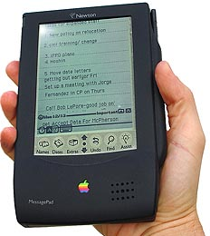
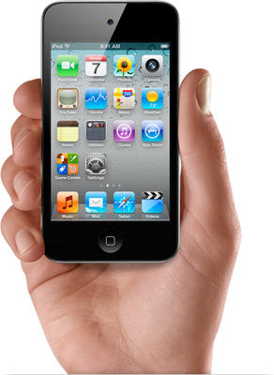

Slide 3
Technology feasibility
Business viability
User
desirability

Slide 4
Technology feasibility
Business viability
User
desirability

Slide 5
How to find your
Without breaking your bank

Slide 6
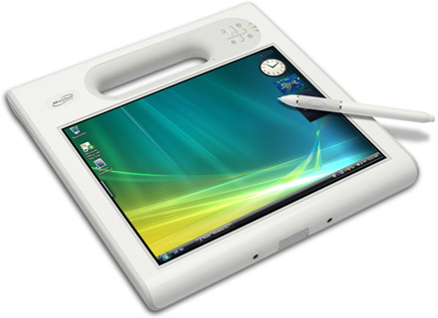
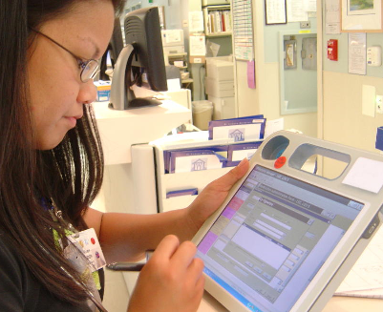
1. Go outside

Slide 7
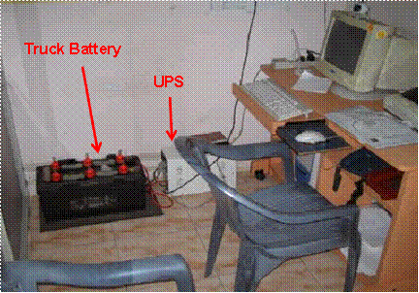
1. Go outside

Slide 8
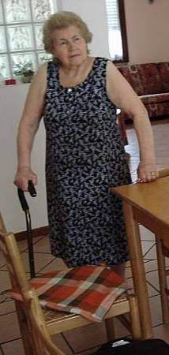
1. Go outside

Slide 9
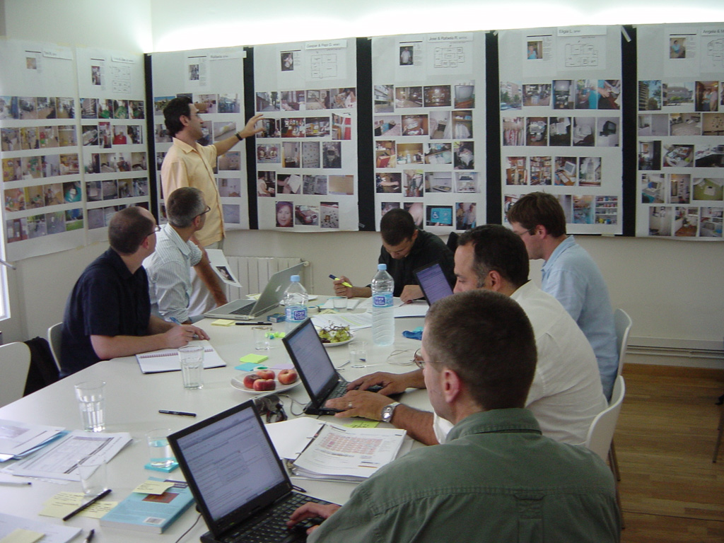
2. Take notes and pictures; share with friends

Slide 10
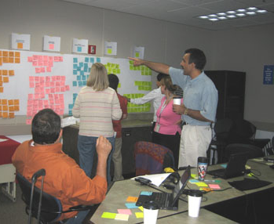
3. Fight about what it all means

Slide 11
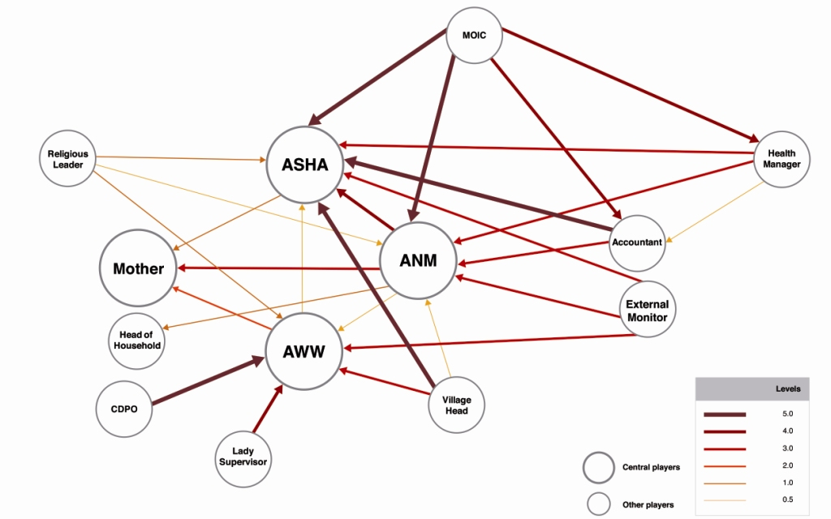
4. Think about
whole systems

Slide 12
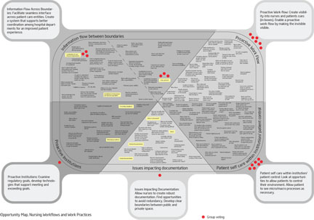
5. Figure out
where you
can play

Slide 13
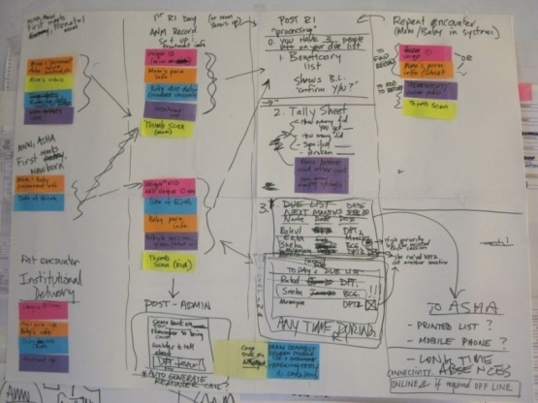
6. Make stuff up

Slide 14
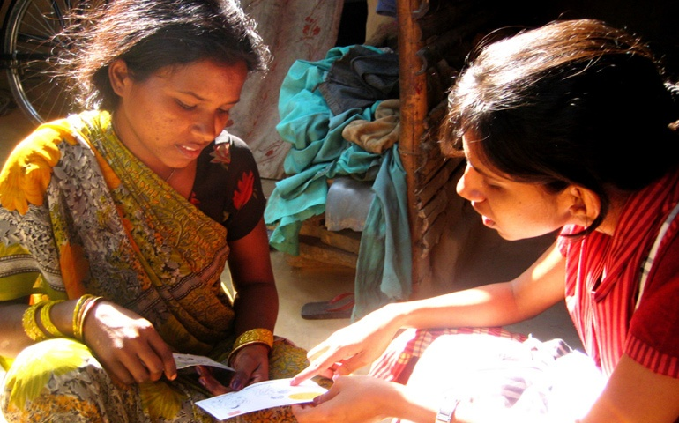
7. Then test it

Slide 15
8. Then test it
some more
Just be sure you know what you’re testing and why

Slide 16
Go outside
Share with friends
Fight about it
Think of whole systems
Find where you can play
Make stuff up
Test it
Iterate
Observant, storytelling
Analytic
Creative
Critical

Slide 18
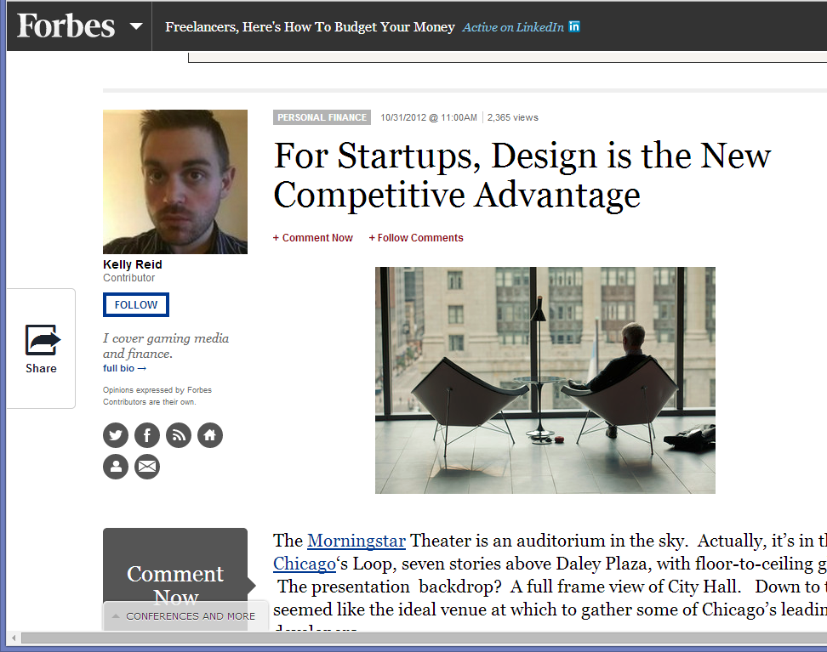

Slide 19
john.sherry@intel.com

