Slide 1
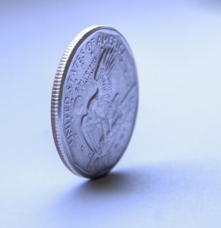
The Other Side of the Coin
From Healthcare
to Wellness
Sophie Nathenson, Ph.D.
Director, Population Health Management
Oregon Institute of Technology

Slide 2
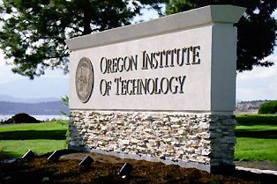
A Medical Sociologist Meets a Tech School
Study of social determinants of health
Health of a society
Applied medical sociology: population health management
Linking the skill sets of research, organizations, navigating different perspectives, taking a system level approach… to the job market.

Slide 3
The Other Side of the Coin
Healthcare: to diagnose and treat illness
Population health management: to prevent and manage conditions in a community
Who’s job is it?
Who currently does it?
Where does it happen?

Slide 4
Education, Industry, Community
Crushing student debt, a rapidly changing job market, a diversifying, aging, and chronically ill population..
Innovation is necessary and can be taught
Students are the link!
YOU will perform the system update

Slide 5
Teaching Innovation… Facilitating Adaptation
Research projects:
gathering intel from the community served
Program development:
providing education and translating research into a project
Program assessment:
determining what worked and what didn’t
Evidenced-based:
using data to motivate and seek funding

Slide 6
Student-Led Research Center
Providing low risk format for implementing innovative ideas
Capitalizing on research skills, creativity
Immediately translating abilities; help systems adapt and serve
Real work experience, minimal student debt, recommendations from professional organizations
Measurable benefits to community

Slide 7
It’s happening now…
Health Impact Assessment
Emergency Preparedness Community Study
Youth-led Coalitions to Prevent Violence and Drug Abuse
Health Education and Free Lunch for Rural Communities
Our Partners: Public Health, Fire Department, Police Force, Non-Profit Organizations

Slide 8
Perform the system update
Adapting to a rapidly changing world
Engaging with your community
Translating your skills in real time
Gathering intel to guide practical innovation
You will create a culture and structure for a healthy society
sophialyn.nathenson@oit.edu

