Slide 1
Unleash the Power of the Group
Large Screen Interactive and Collaborative Computing
Peter Oehler
6 May 2016

Slide 2
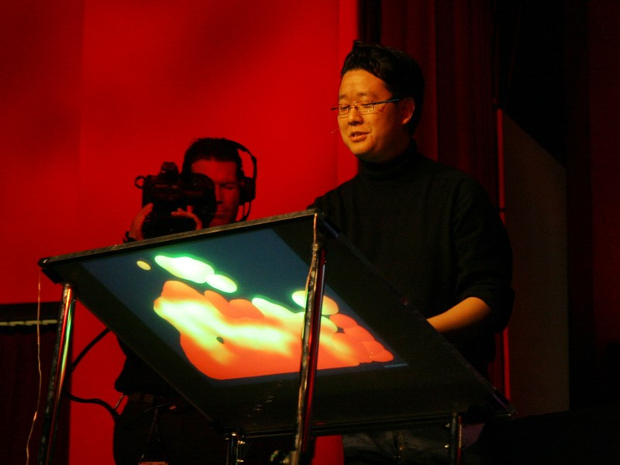
TED Talk 2006 – Jeff Han
Demonstrated high performance multitouch displays before iPhone
Scalable to large sizes
Utilized Frustrated Total Internal Reflection (FTIR) principles to detect touch

Slide 3
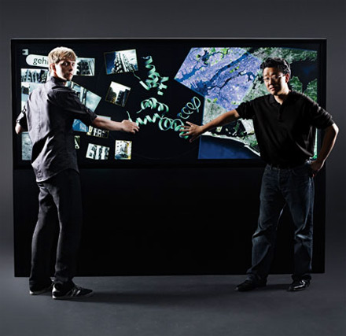
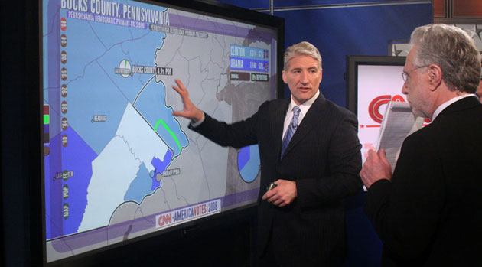
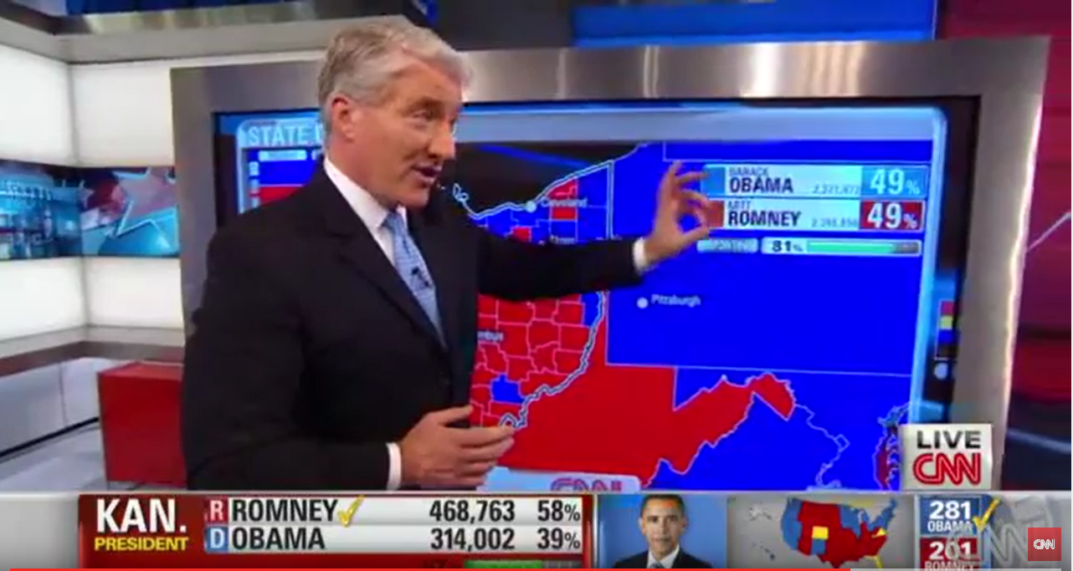
Perceptive Pixel
Jeff formed a company, built a team and commercialized the idea
Incredible performance at low volume and with a high price
Breakout with CNN Election Coverage in 2008 and 2012

Slide 4







Evolution of PPI Technology
3 Chip DLP Projector
55” LCD FHD
82” LCD FHD
84” LCD UHD
OLED
Robust FTIR
(ambient insensitive)
Projected Capacitive
FTIR
FTIR Through LCD
Image Processing
Single Camera (60Hz)
Image Processing
(4 Cameras, 120Hz)
Image Processing
(Capacitive Sensor)
Discrete electronics
Custom ASIC’s
Basic Marker
Improved Marker
Better Marker
Demo Software
Feltboard
DevKit
Vertical Markets
Mapping
Broadcast
Geological Exploration
General Markets
We/There
StoryBoard
Office apps
Partner Apps
Windows 7
Windows 8
Windows 10
Prototype Manufacturing
Low Volume Factory
Volume Factory

Slide 5
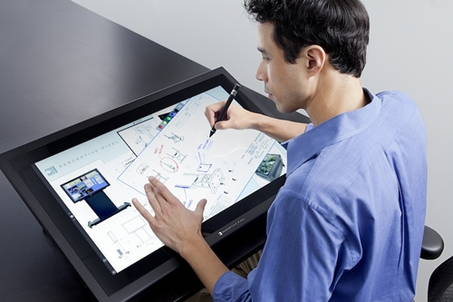
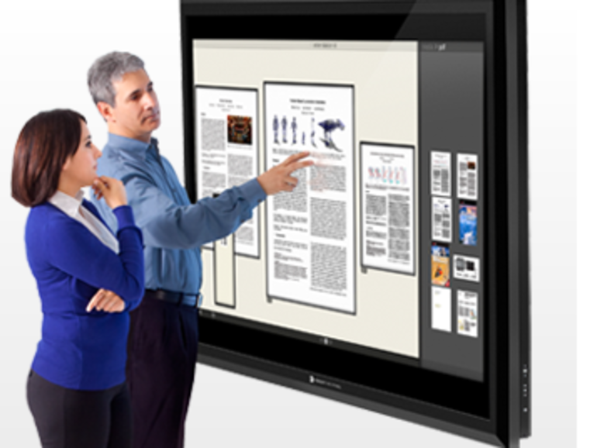
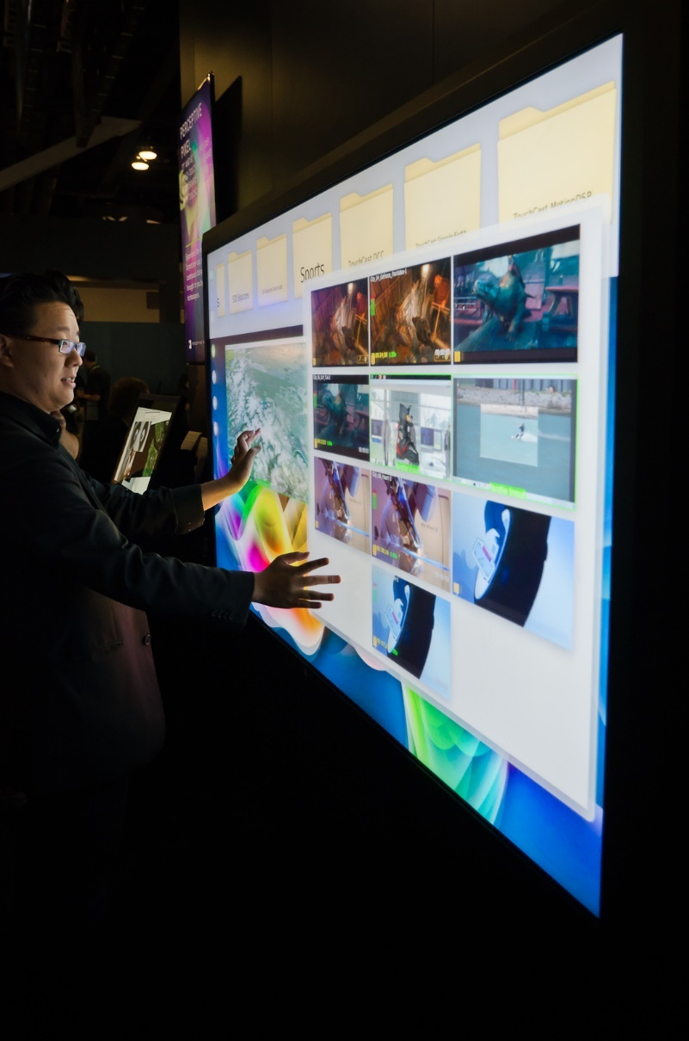
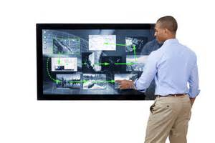
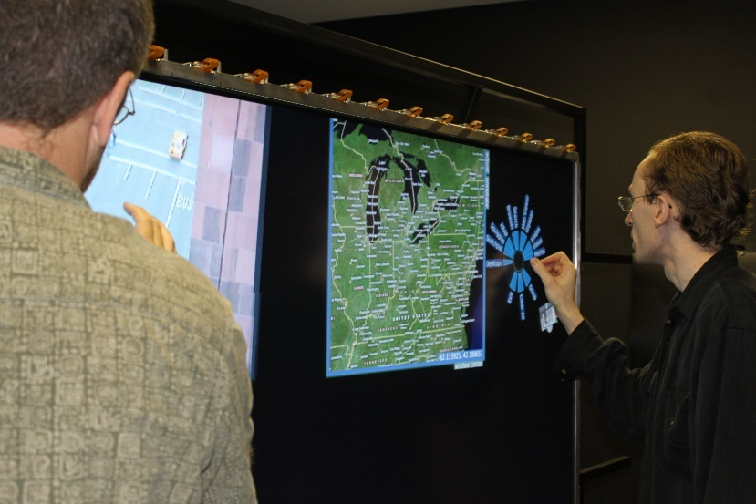
Technology Development

Slide 6
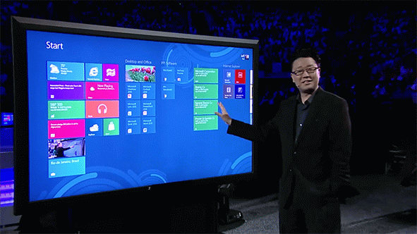
Microsoft Acquisition
In the July, 2012, PPI was acquired by Microsoft which provided an opportunity to bring together state of the art hardware and integrate it tightly with OS, Apps and Services
+
+
+
Hardware
Software
Services
Apps

Slide 7
Rethinking Collaborative Computing
Placing a Personal Computer in a Collaborative Workspace does not work
Best way to create and brainstorm with others
Engaging and productive meetings
Platform for amazing large screen apps
Designed for the modern workplace

Slide 8
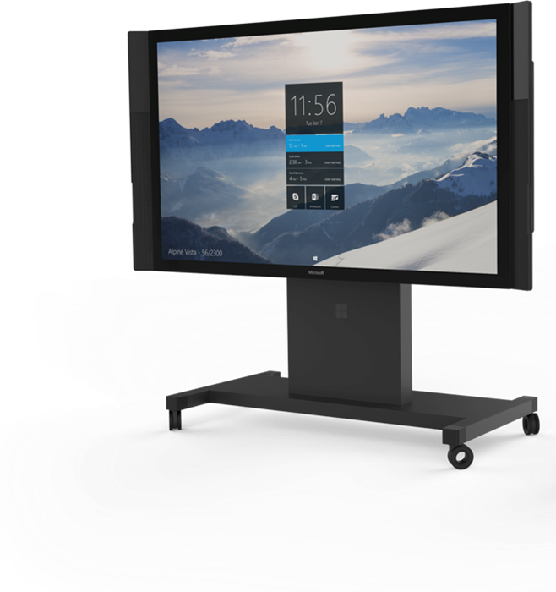
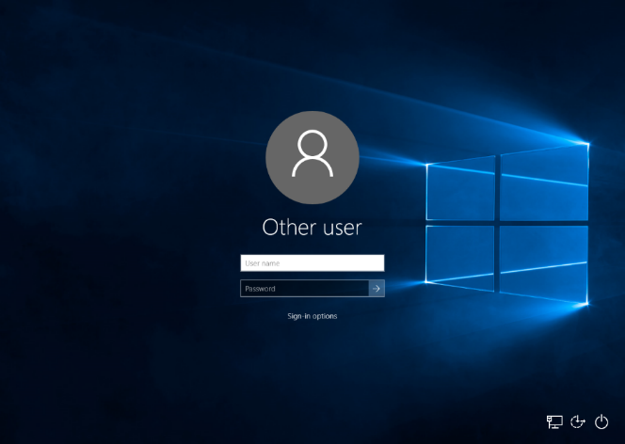
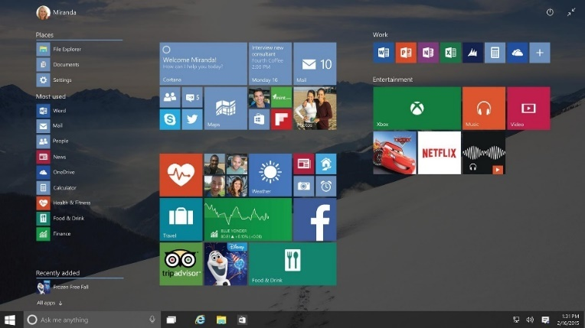
Rethinking Collaborative Computing
Walk Up and Use
  Always on and ready for you
  Eliminate username and password
Simple and Discoverable
  Make the experience consistent
  Reduce clutter and make capabilities clear

Slide 9
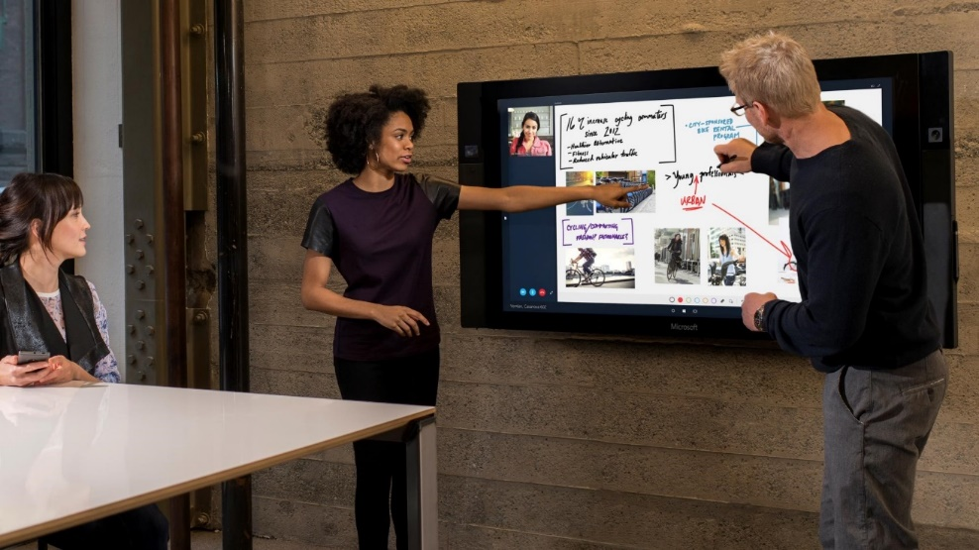
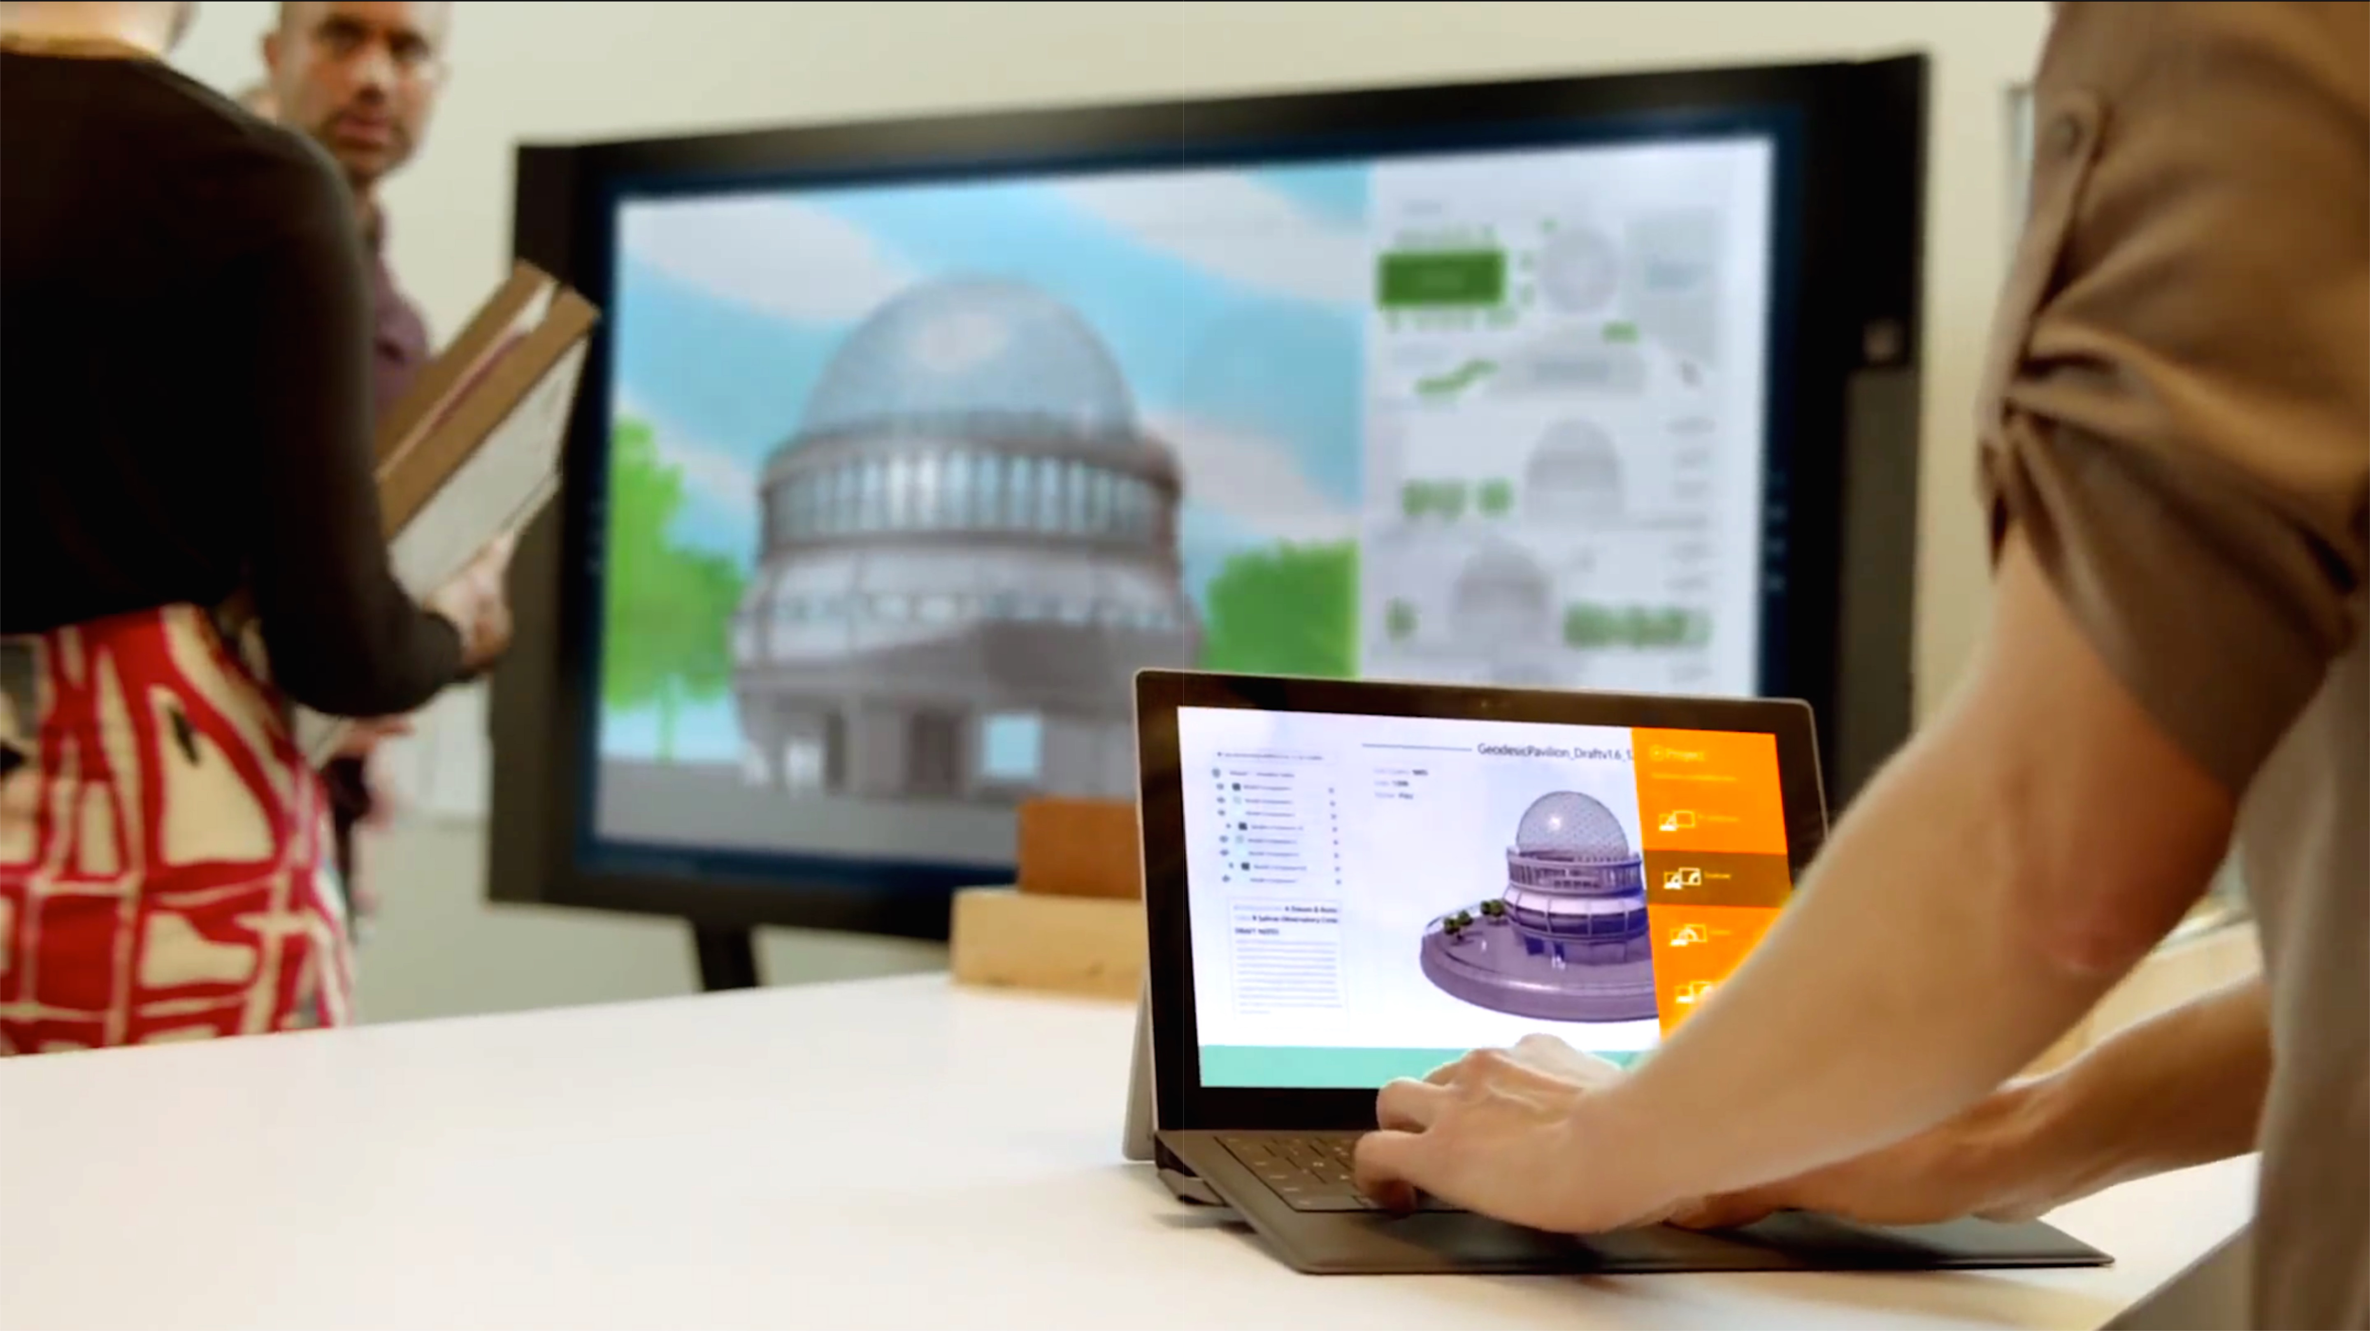
Group Collaboration
Digital Whiteboard
  Natural and fluid inking on an infinite canvas
  Pull in content from anywhere
  Save and share
  Pick up where you left off
Connect your Devices
  Present your screen over a wired or wireless connection
  Interact with the large screen as an extension of your PC, tablet or phone

Slide 10
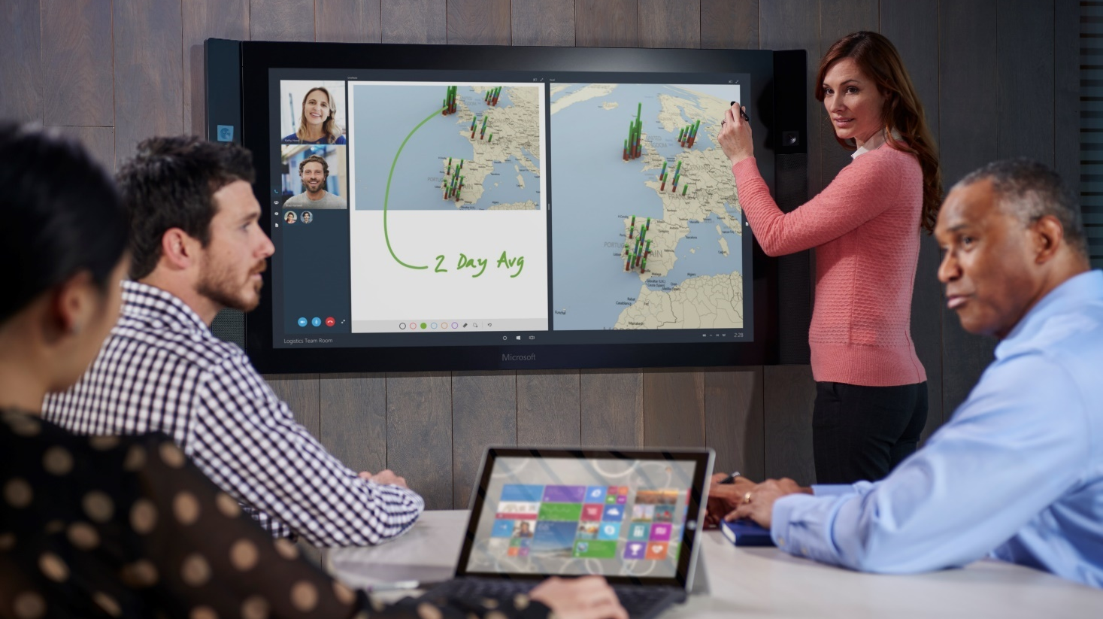
Rich Remote Collaboration
Almost 50% of all meetings have remote participants – are they really engaged?
Build a better meetings experience with the remote participant as first class citizen
  Deep Skype integration
  Purposeful placement of cameras and gallery
  Custom cameras, mic arrays and speakers

Slide 11
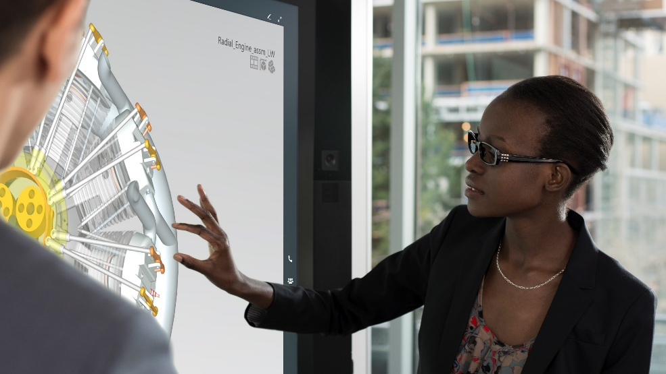
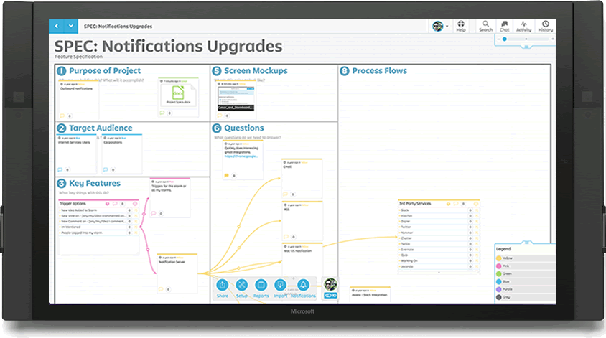
Platform for Large Screen Apps
Use extends beyond Skype calling and digital white boards
  Deep integration with Office applications
  Rich data visualization with Power BI, Project Sanddance, etc.
Partner Community building great new experiences
  Brainstorming tools like Stormboard and Mural
  Training tools like Techsmith Loop
  CAD visualization from Siemens and Autodesk
  Many more in development

Slide 12
Future Challenges

Slide 13
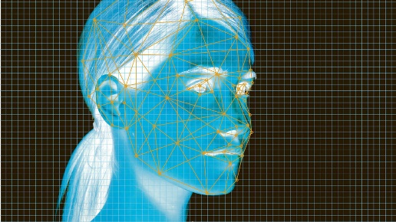

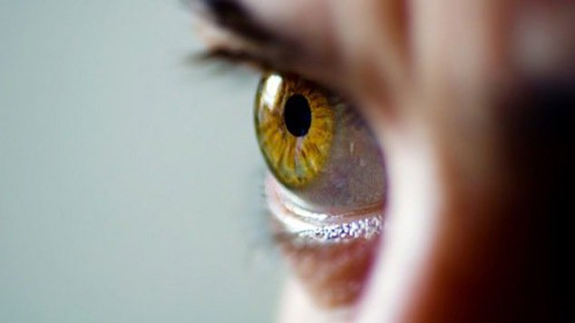
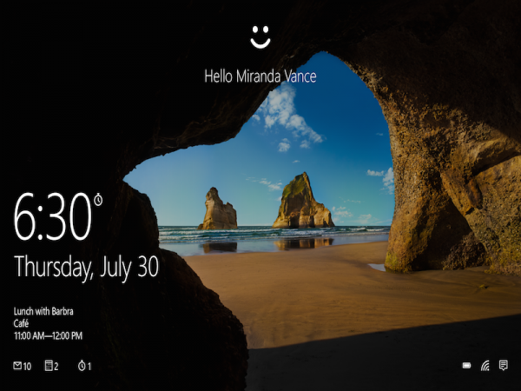
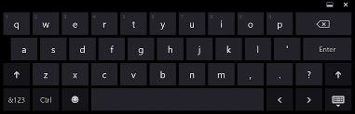
Access Your Content on a Communal Device
The cloud makes your data and content very portable, but how can you access it easily?
  A traditional login may not be ideal
  Biometrics are fast and you can never forget them, but how can we apply at scale?
  How might this extend to a public device? Privacy? Security?

Slide 14
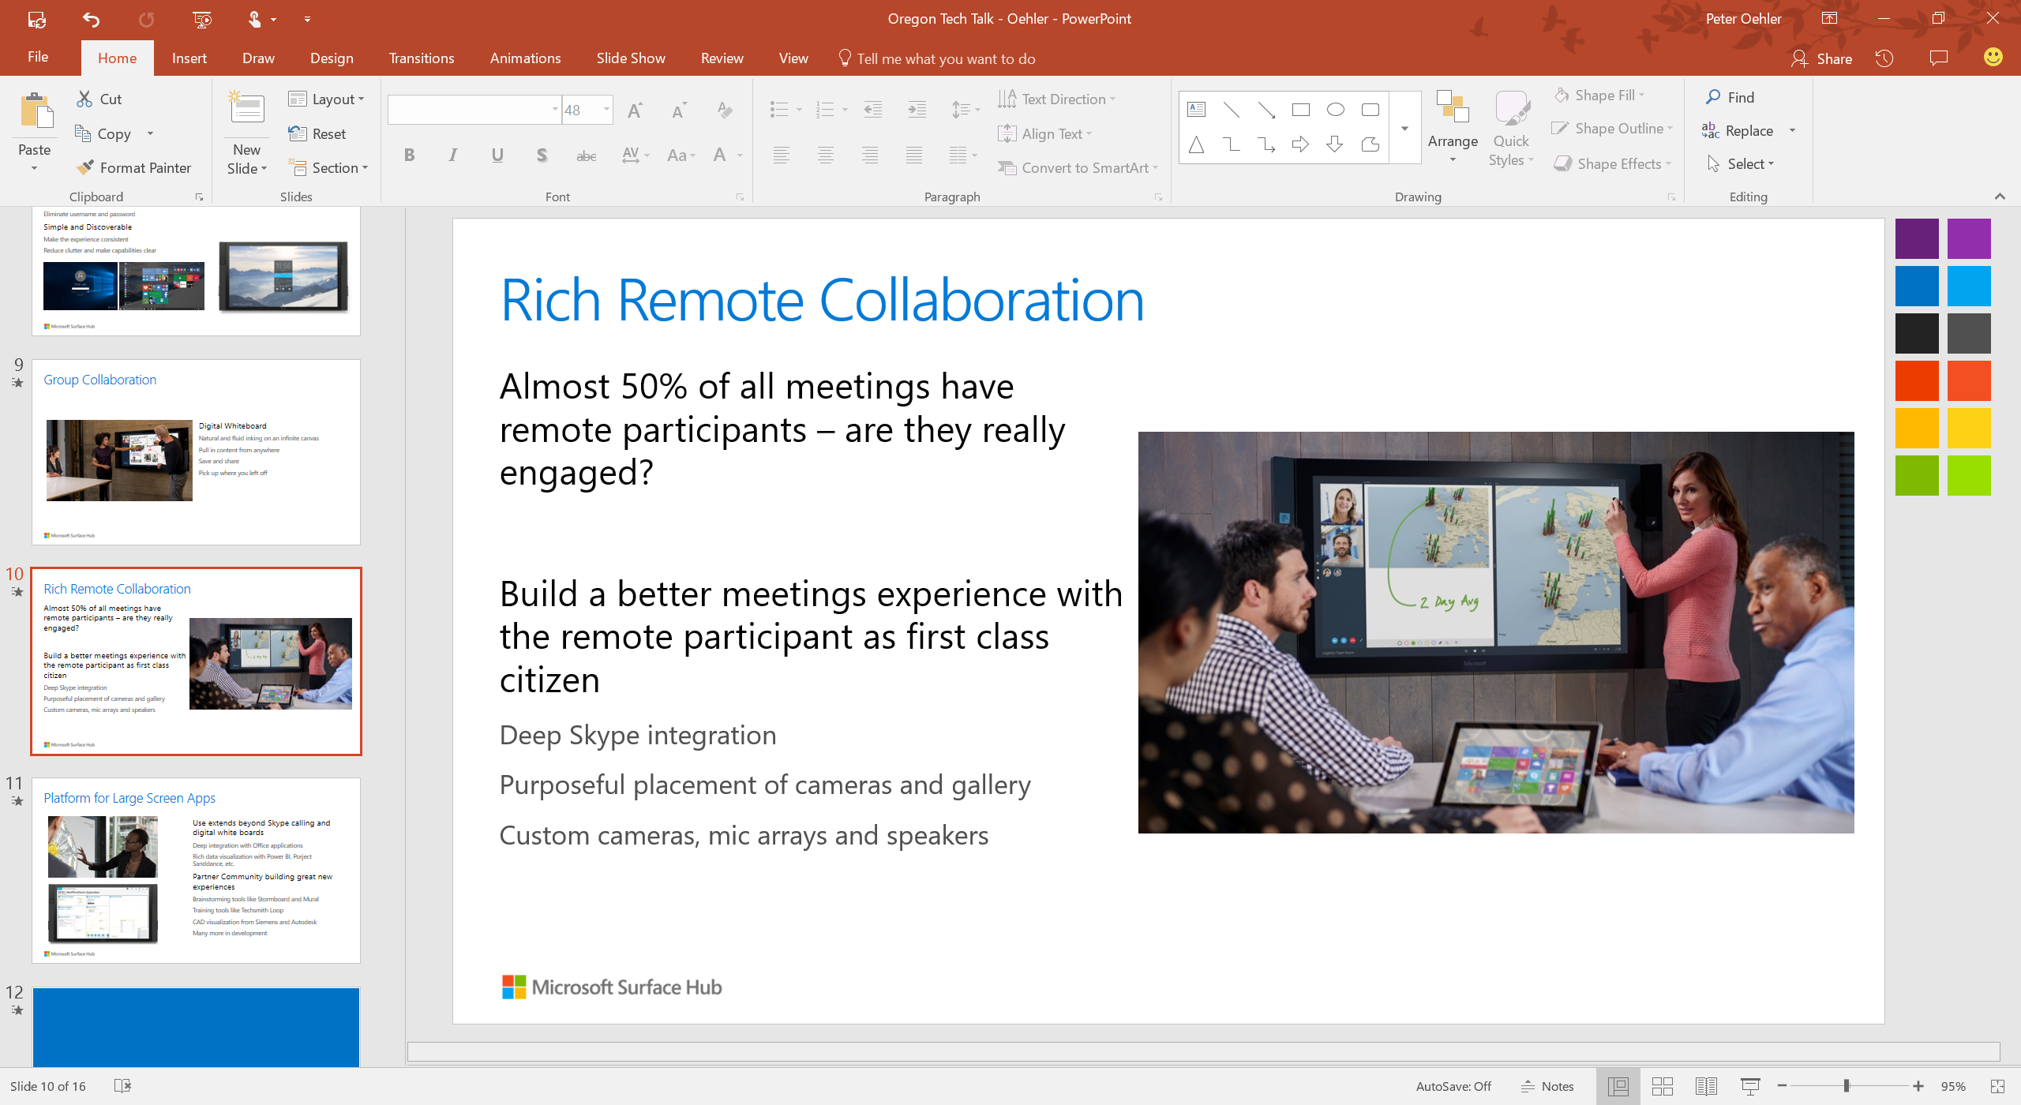
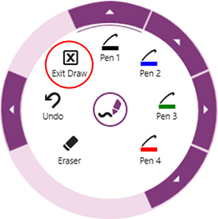
Interface - Problems at Scale
How do we take advantage of the large screen area while preserving the productivity that comes with a familiar desktop interface?
  UI is packed around the perimeter and designed for mouse and keyboard
  Single User and Single Task focused
  Traditionally considers one compute device

Slide 15
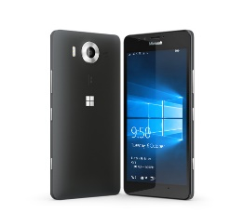
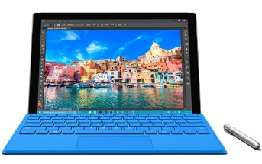
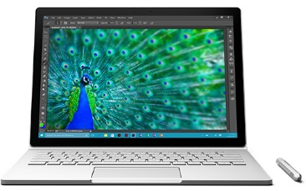
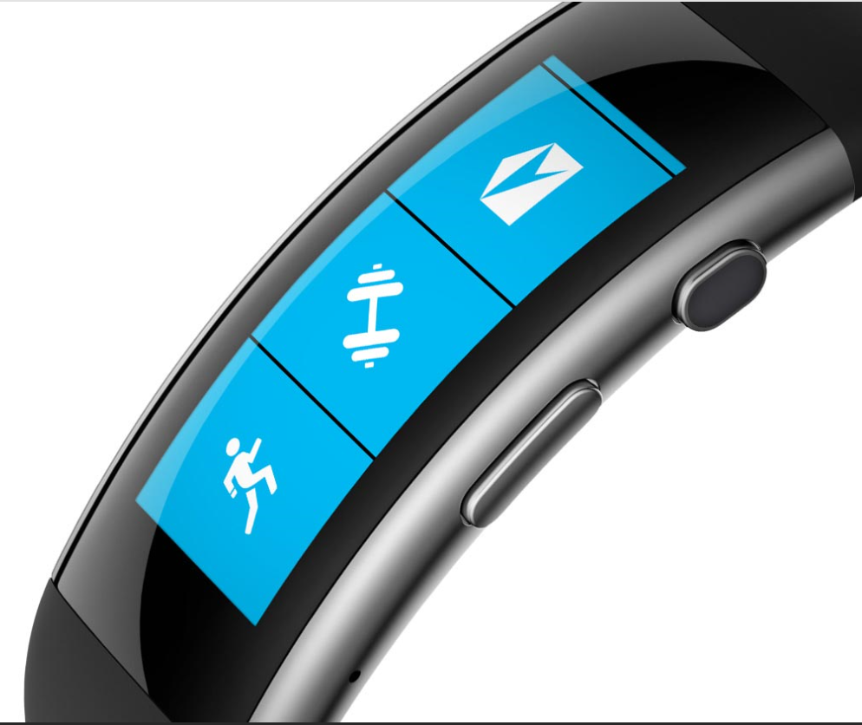
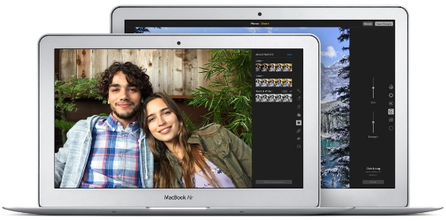
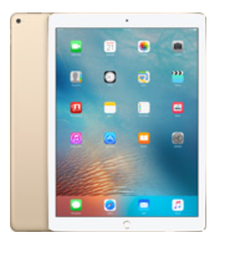
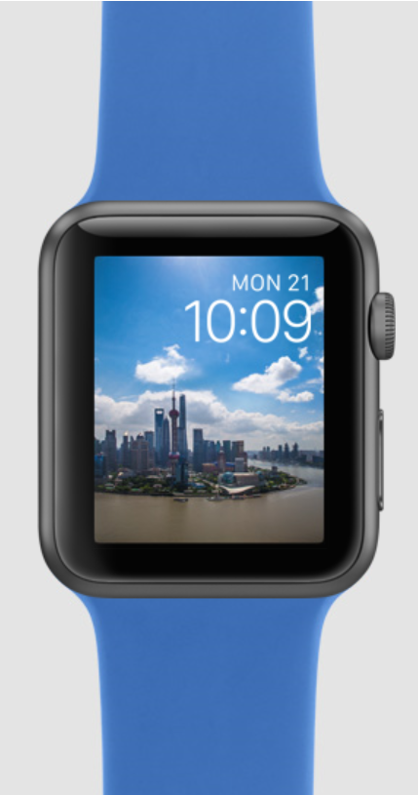
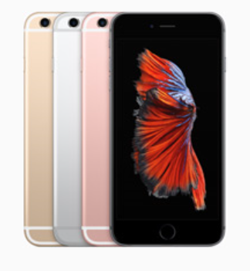
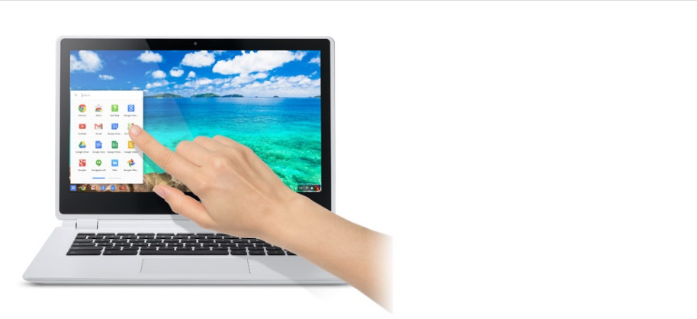
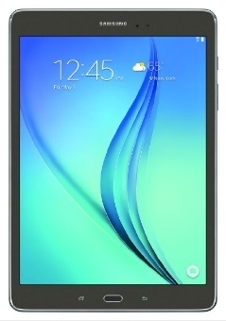
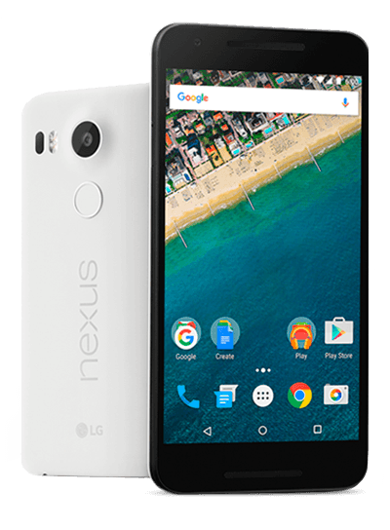
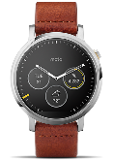
Use Model - Proliferation of Smart Devices
Existing Challenge – BYOD
  Multiple wearable, phone and tablet platforms added to the existing traditional Mac and Windows landscape
  Computing is very mobile, very multifaceted and comes with new interfaces and capabilities
  Cloud presence is formative now with Google, Apple, Amazon and Microsoft active in the field with many smaller but important players like Dropbox and Slack
What does a future product look like that really takes advantage of this proliferation of devices and persistent cloud presence?

