Slide 1
Efficiency Power Plants
May 12, 2017
Christopher Dymond
Sr. Product Manager

Slide 2
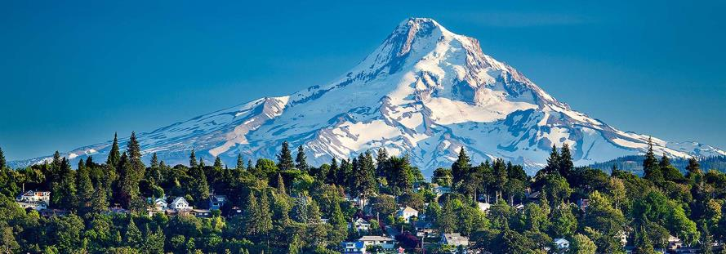
Today’s Talk
The Northwest & Energy Efficiency
NEEA & Market Transformation
Notes:
2

Slide 3
A bit of History
1970’s – The Last Big Power Decade
Last Main Stem Columbia River Dam (1975)
Salmon runs on Snake River decline
Nuclear Power Investments default (WPPSS)
1980 – The Northwest Power Act
A regional conservation and electric power plan
A program to protect, mitigate, and enhance fish and wildlife.

Slide 4
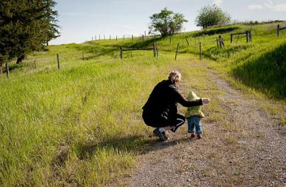
The Northwest’s Energy Goal
Meet the region’s future energy demands at the lowest possible cost
Achieve a secure, environmentally sustainable future

Slide 5
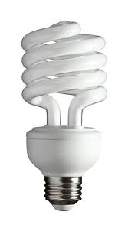
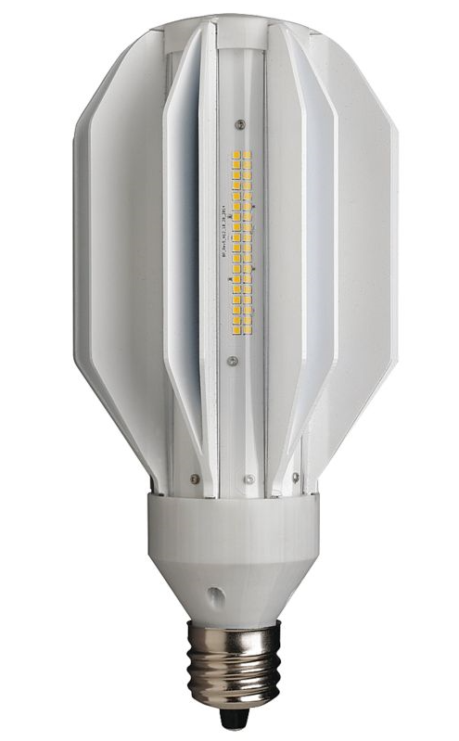
Efficiency = Same Value / Less Energy
16 LPW
66 LPW
133 LPW
330 LPW
Lumens Per Watt (LPW) = Light Output / Energy In

Slide 6
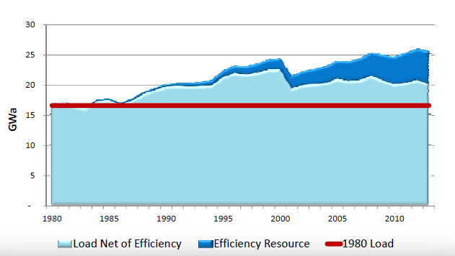
How much has the region saved?
5600 aMW Saved since 1980
Can serve all of Oregon and Western Montana
Saves $3.5B/Year
Saved 21.9 MTC in 2013
Notes:
Energy efficiency is now the second-largest resource in the Pacific Northwest, behind only hydropower. Total regional investment in energy efficiency in 2013 was $375 million (2006 dollars). The investment was a bargain compared to the cost of building new power plants. The average cost of efficiency improvements was about $17 per megawatt-hour, about five times less than the cost of power from a new gas-fired plant.

Slide 7
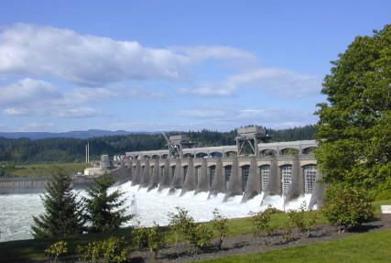
Compared to Bonneville Dam
Bonneville:
Cost: $2.8B (2006 dollars)
Construction time: 11 years
Capacity: 1100 aMW
Efficiency: (2010-2013)
Cost: $1.5B
Construction time: 4 yrs
Capacity: 1050 aMW

Slide 8
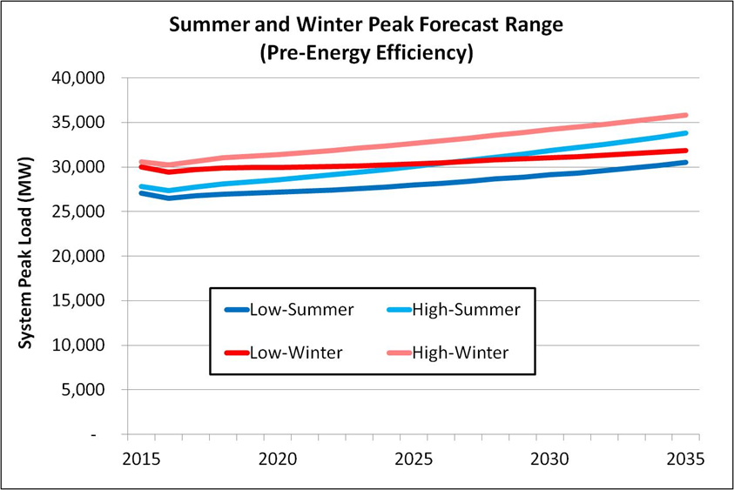
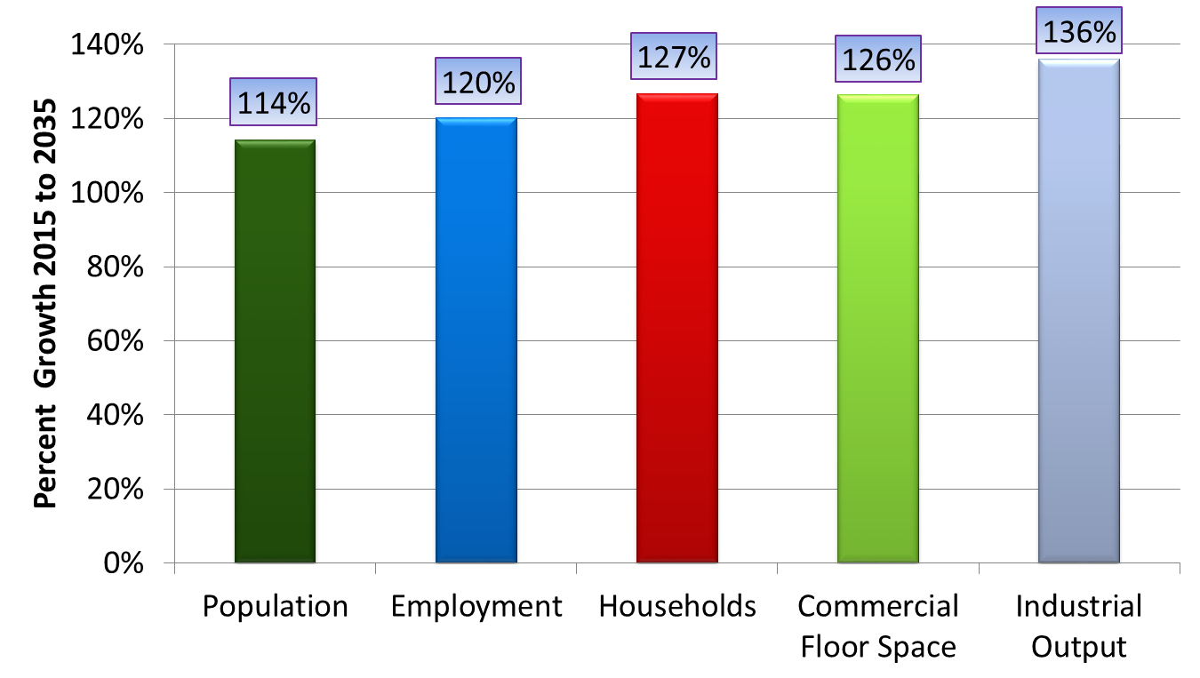
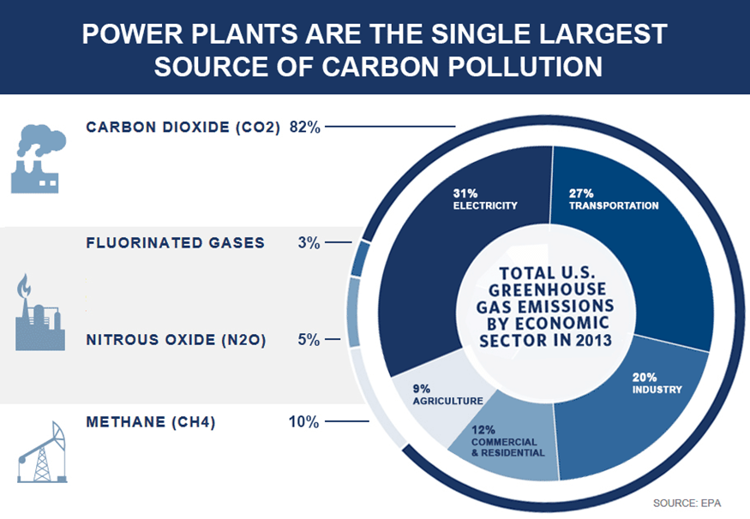
Major Challenges Ahead
Climate Change
Economic and Population Growth
Aging Infrastructure

Slide 9
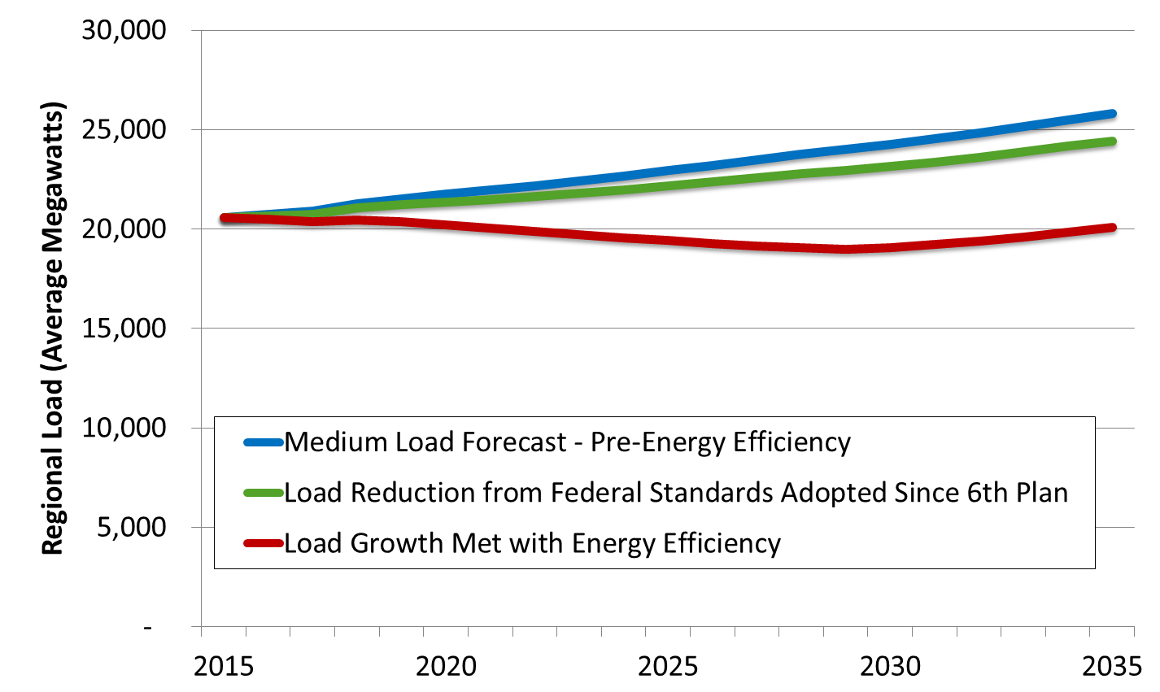
NWPCC Forecast Load Growth Over The Next Two Decades

Slide 10
Key Finding:
The Seventh Power Plan Relies on Energy Efficiency and Demand Response Resources To Meet Load Growth
Because they cost less!

Slide 11
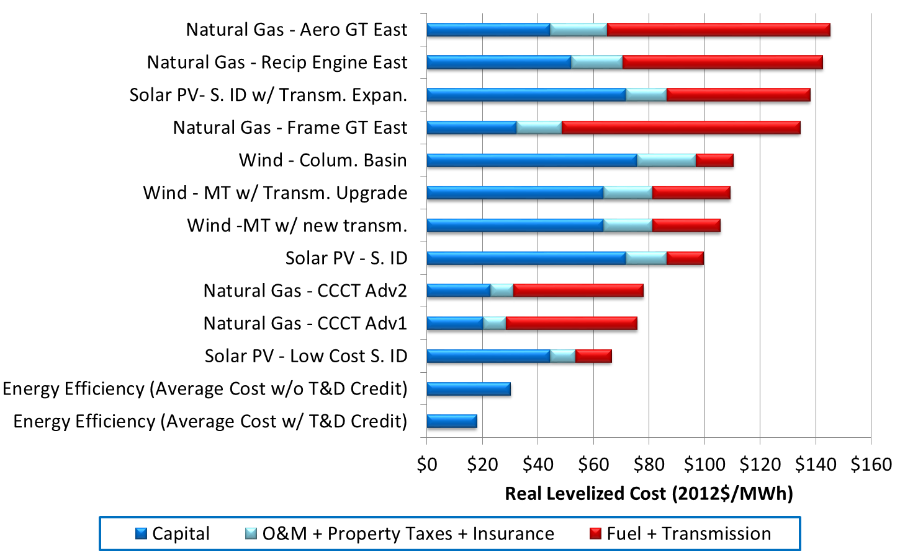
Resource Scenarios

Slide 12
NW Efficiency Players
Market
NWPPC
Utilities
Regulators
Policy Makers
Annual Rain
EE Contractors
NEEA
Bonneville Power Administration

Slide 13
The Northwest Energy Efficiency Alliance (NEEA) is a nonprofit organization working to effect market transformation through the acceleration and adoption of energy-efficient products, services and practices. NEEA is an alliance of more than 140 Northwest utilities and energy efficiency organizations working on behalf of more than 13 million energy consumers. For more information, visit neea.org.
Northwest Energy Efficiency Alliance (NEEA)

Slide 14
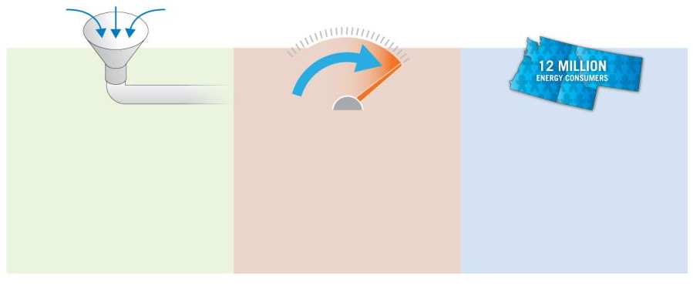
How NEEA Accelerates Energy Efficiency
13 MILLION
ENERGY CONSUMERS
NEEA Fills The Energy Efficiency Pipeline
NEEA Accelerates Market Adoption
NEEA Leverages the Power of the Region

Slide 15
How We Work
Dollars Invested
Codes & Standards
Natural Baseline
Market
Market Share
Transformation
Emerging Technologies
Early Market Adoption
Mainstream Market Adoption
Time
Notes:
We believe that markets work we are helping to accelerate them
This chart shows the way we work at the highest level. What we do is of value to the region, because we use the combined market power of the region to intervene in the market to increase the adoption of energy efficient products, services and practices.
We work to remove market barriers and obtain regional funding at the beginning of an initiative to provide incentives to motivate early adopters. As the initiative grows, the funding decreases and eventually incentives go away, but the savings continue.
15

Slide 16
20-years of Market Transformation
Building Efficiency Power Plants

Slide 17
Current NEEA Portfolio
Consumer Products
Retail Product Portfolio
Super Efficient Dryers
Heat Pump Water Heaters
Ductless Heat Pumps
Commercial / Industrial Lighting
Top Tier Trade Ally
Integrated Design Labs
Reduced Wattage Lamp Replacement
Luminaire Level Lighting
Natural Gas
Clothes Dryers
Rooftop HVAC
Gas Heat Pump Water Heater
Hearth Products
New Construction
Certified Homes/Next Step Homes
Commercial Code Enhancement
Manufactured Homes
Next Step Homes
Other Markets
Commercial Secondary Glazing
Commercial Real Estate
Commercial & Industrial Strategic Energy Management
Industrial Technical Training
Building Operator Certification Expansion
Refrigeration Energy Specialist Certification

Slide 18
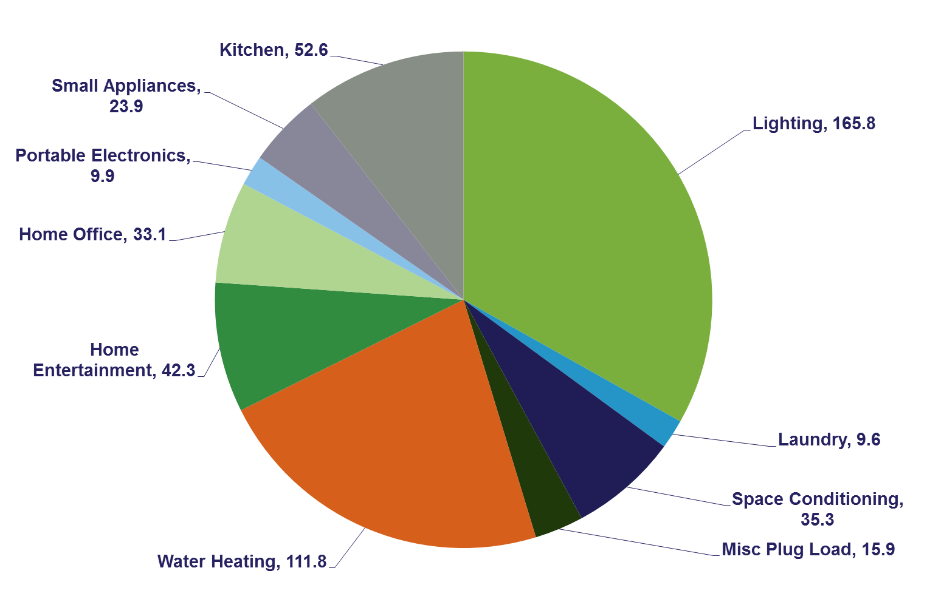
Example: Retail Product Portfolio
500 aMW
Calculations from Energy Solutions, Navitas Consulting and ENERGY STAR
Notes:
You may have seen this slide before as well,
The 85 million units purchased in the NW consume about 500 aMW. This amount goes into the market every year.
ENERGY STAR believes there is a savings potential of greater than 10% in Consumer Electronics and Appliances
Take Away:
Working with Nation Retail gives the region its best chance at reducing this number.

Slide 19
Conclusion
NW Power and Conservation Council develops 20-year plans every 5 years for
Fish habitat
21 GW of electric power generation
NW Utilities spend several hundred million/yr year on energy efficiency
Least cost, lowest pollution option
Built 5.6GW of energy efficiency – saving $3.5B/yr
Most growth over the next 15 years will be met with energy efficiency, not new generation capacity

Slide 20
Thank you!

