Slide 1
Microsoft Surface Studio
AN INSIDE LOOK AT

Slide 3
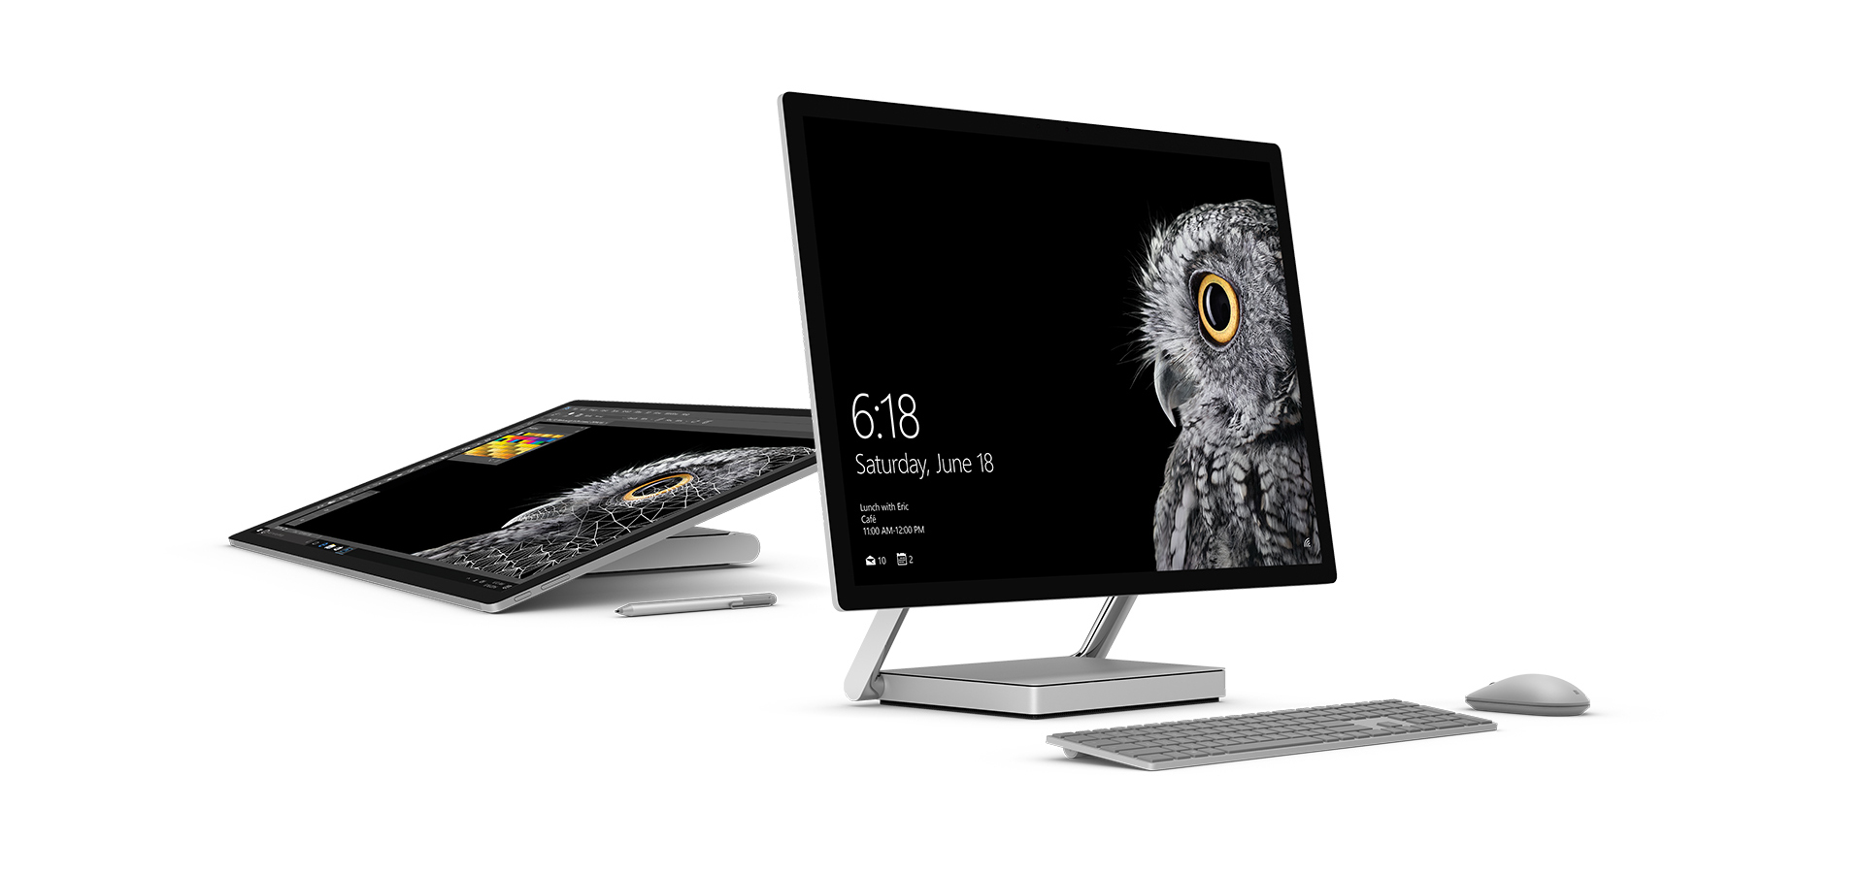
What is Surface Studio?
A desktop PC aimed at creators, to give them all the tools and power they need to practice their craft, as well as perform everyday computing tasks such as email and web browsing, all in one place
Elegant design – a “Floating Sheet of Pixels”, with the thinnest LCD monitor ever built
Transforms the desk into a Studio, allowing the user to be immersively engaged with the touch screen canvas

Slide 4
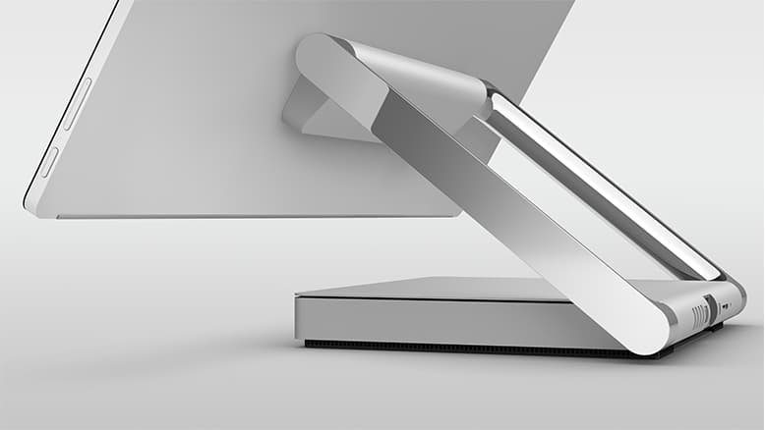
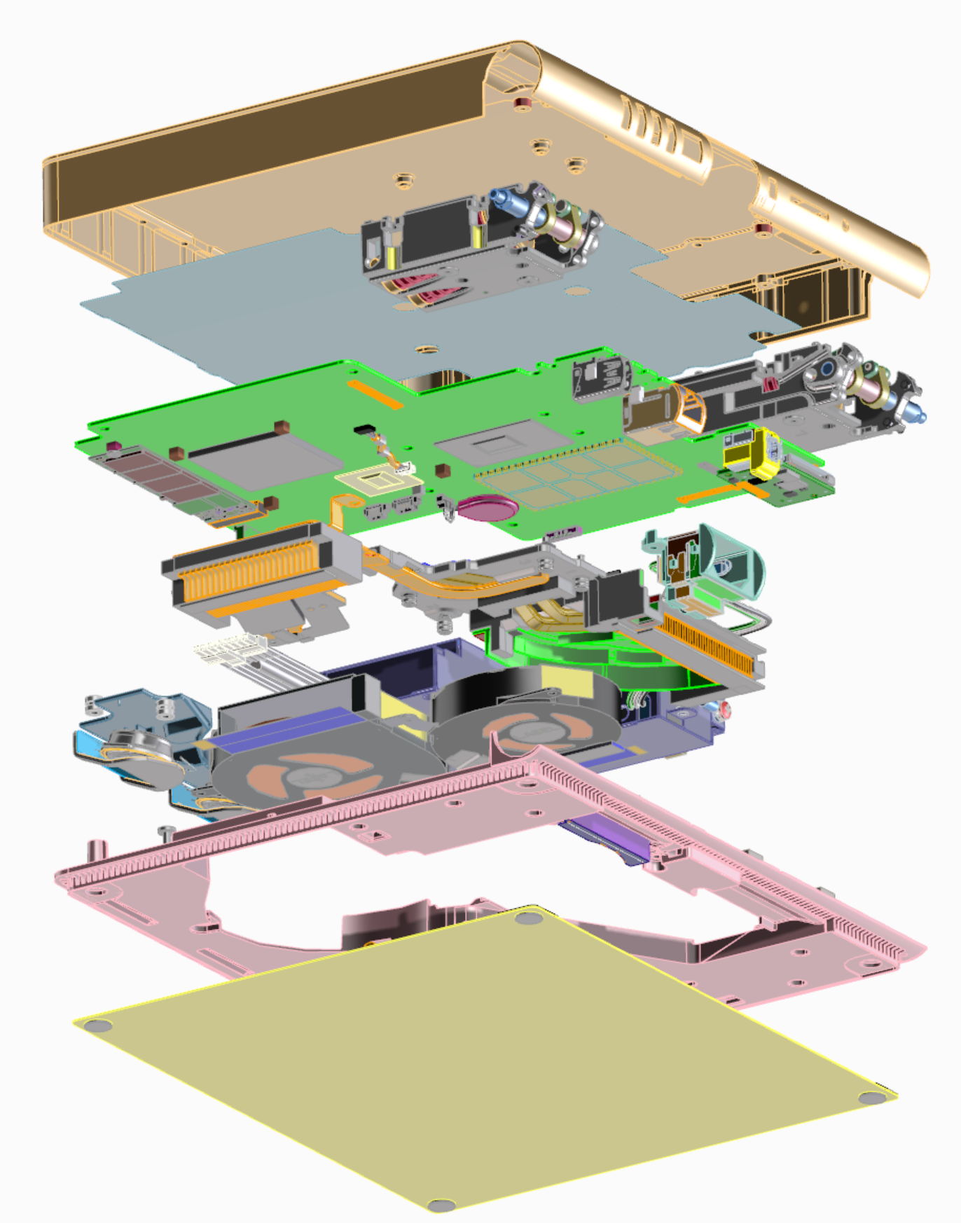
Base System
Performance
CPU: QuadCore i5 or i7 6th Gen Intel Core Processors
GPU: Nvidia 2GB GTX 965M or 4GB GTX 980M
Storage: 1TB or 2TB using SSD/HDD Rapid Hybrid Drive
System Memory: 8GB / 16GB / 32 GB RAM
Features
4 USB 3.0 ports, mDP, SDXC, GB Ethernet
Audio Headset Jack
Kensington Lock Feature
AC Power Outlet
Speaker
Internal PSU: 270W
Compact, low-profile product design
250 x 220 x 32.2 mm
Hinge Base Brackets
Graphite Heat Spreader
Main PCBA
Thermal Module
Fans
Speaker
Power Supply

Slide 5
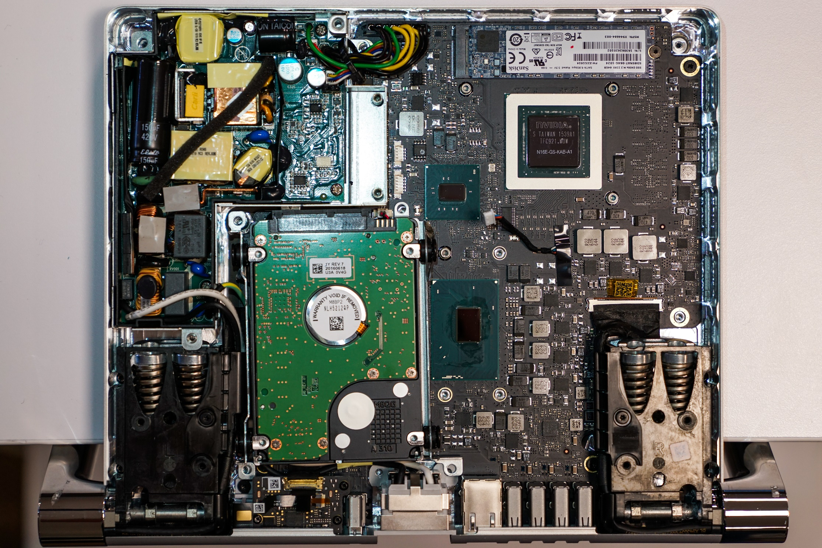
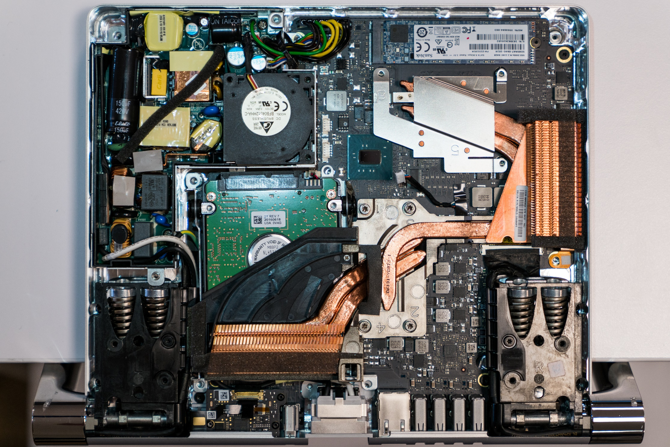
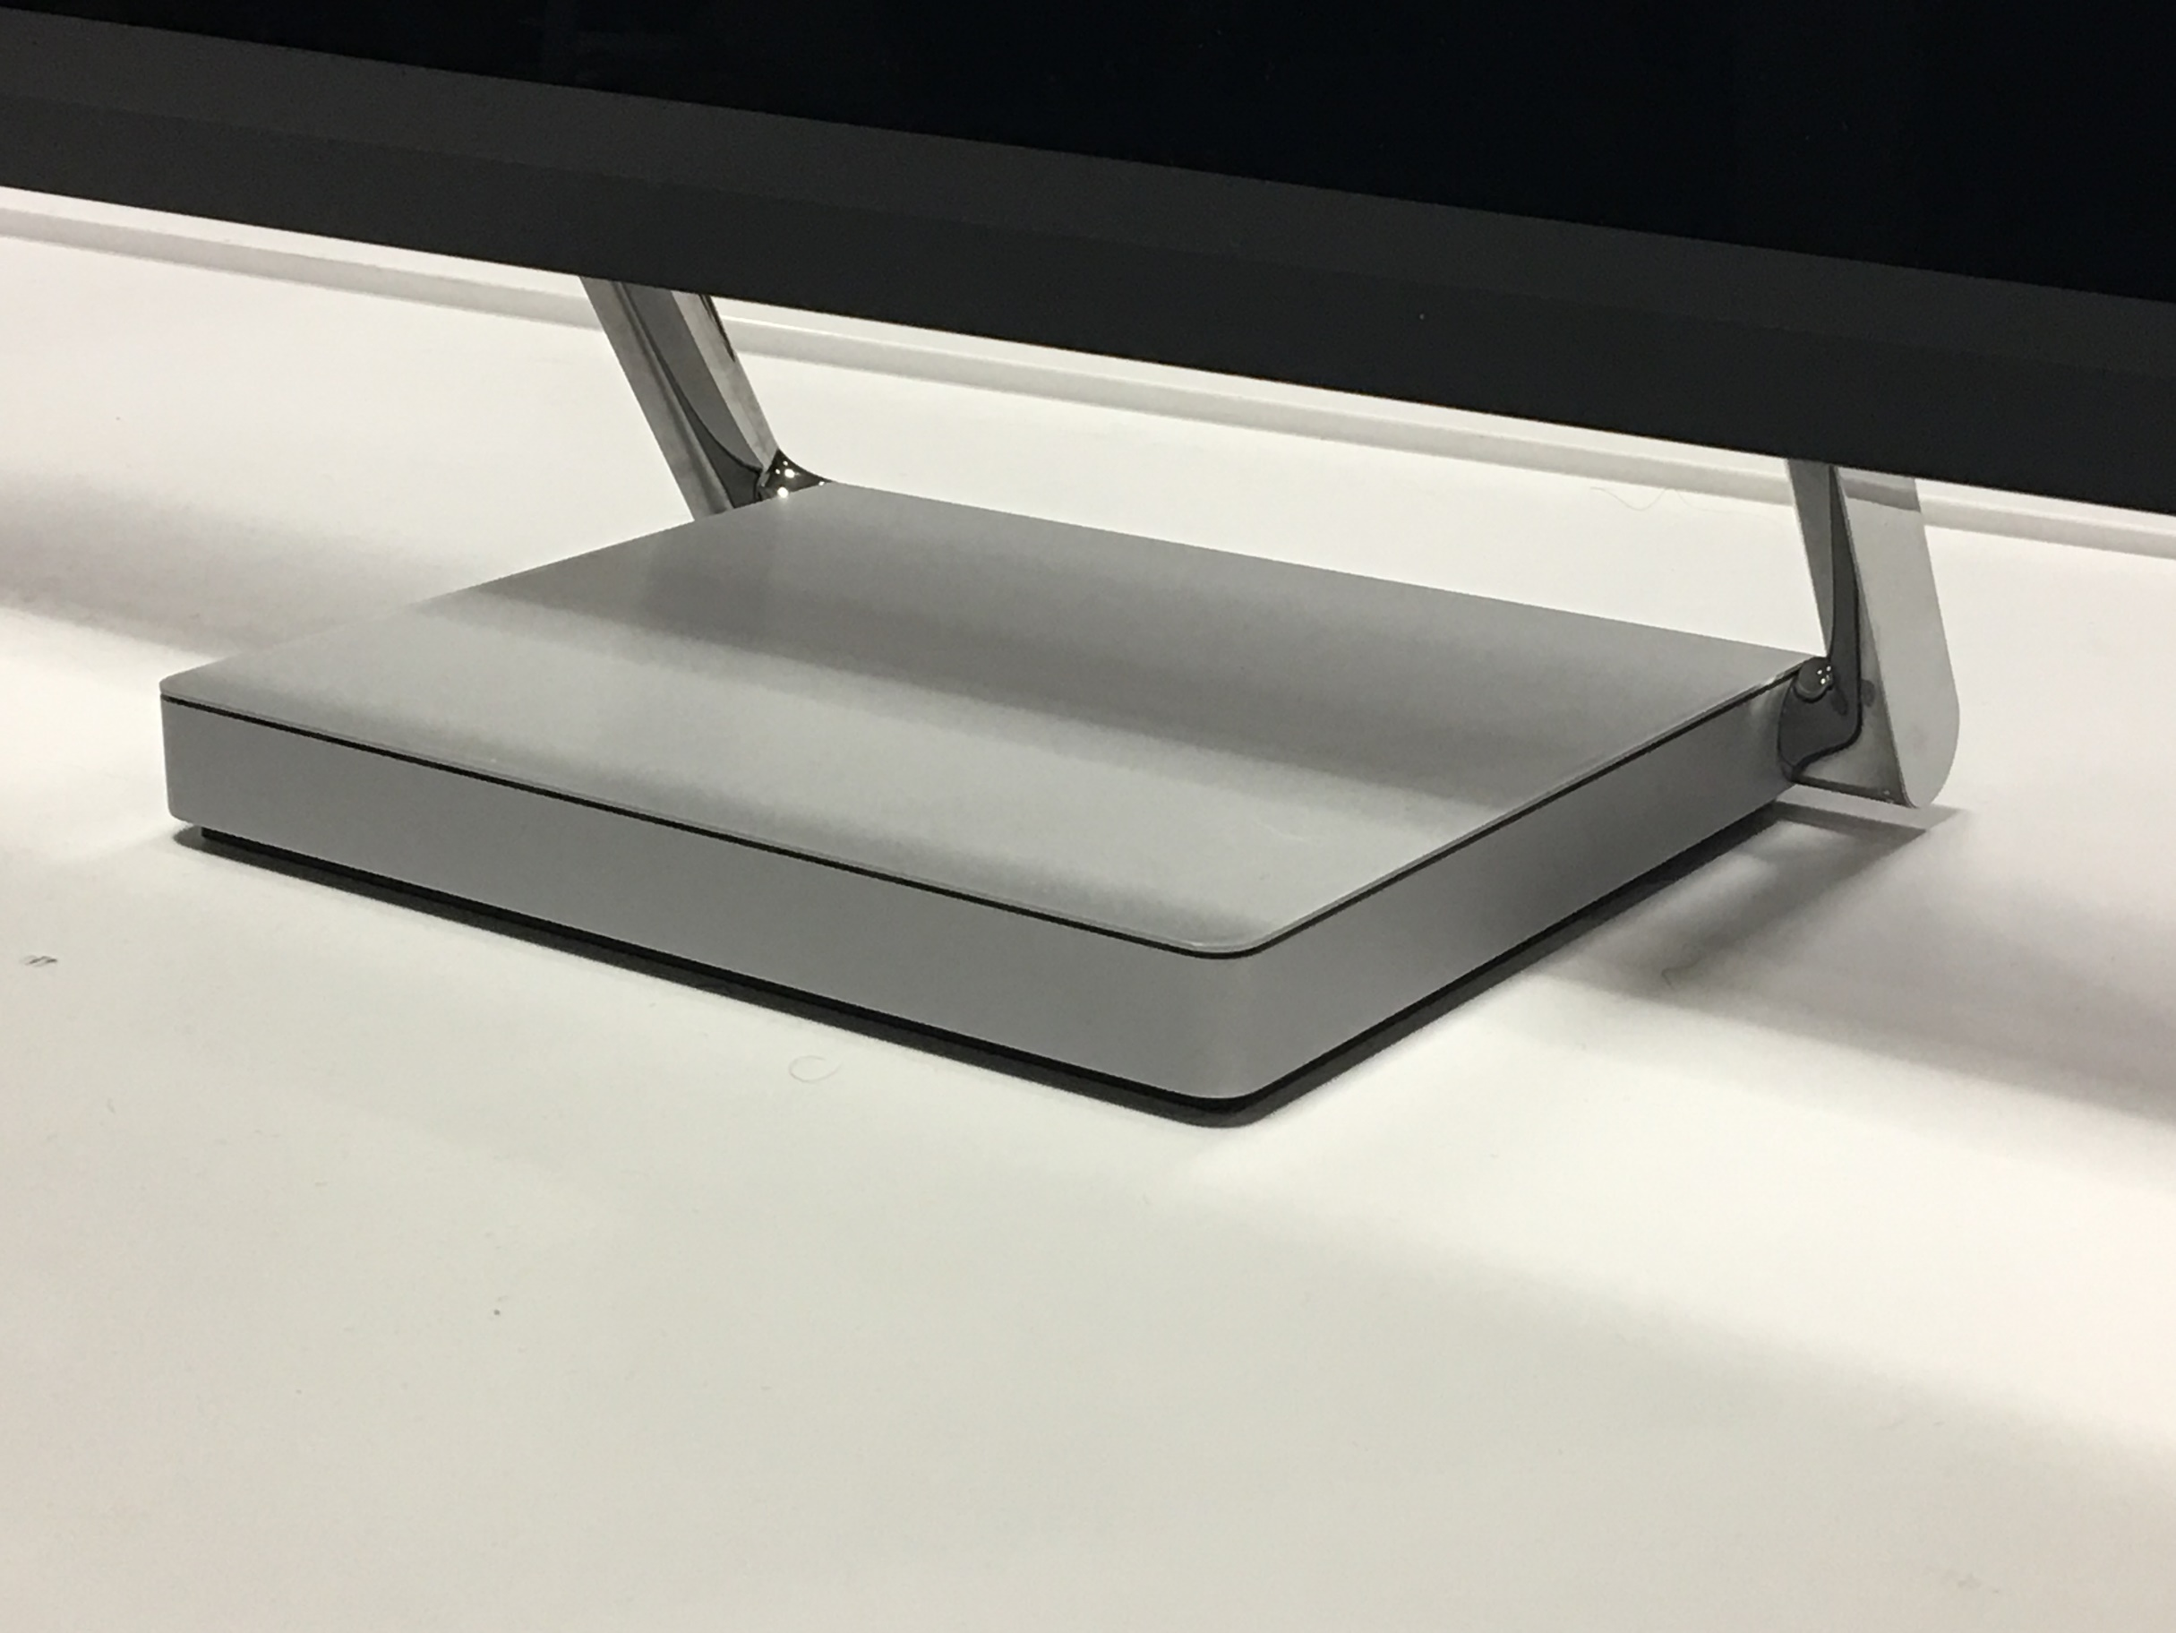
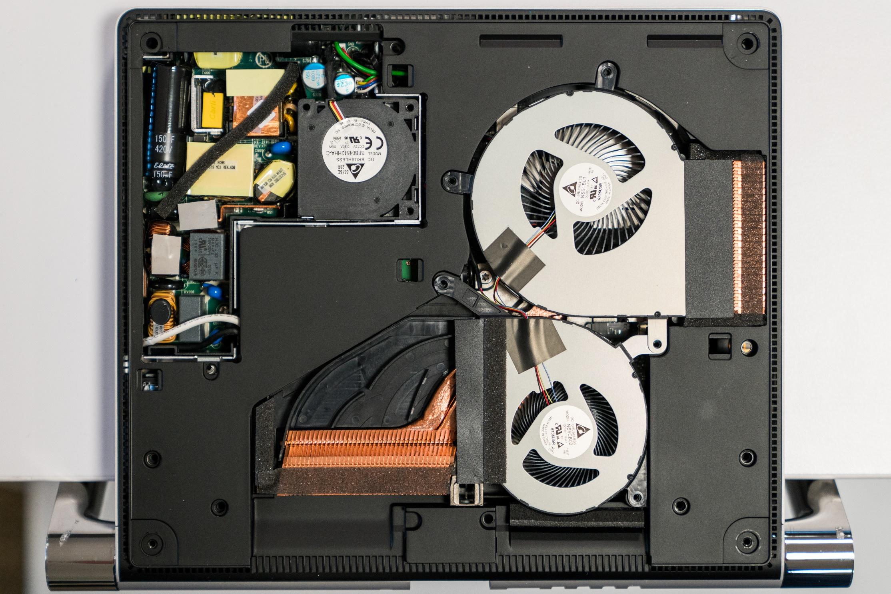
Base Thermal Management
Heat Sources
Thermal Module
PSU
GPU
Heat
HARD
DRIVE
RADIATOR
CPU
Heat
AIR DIRECTOR
Heat
RADIATOR
Cool Air
PSU
FAN
GPU
FAN
Hot Air
CPU
FAN

Slide 6
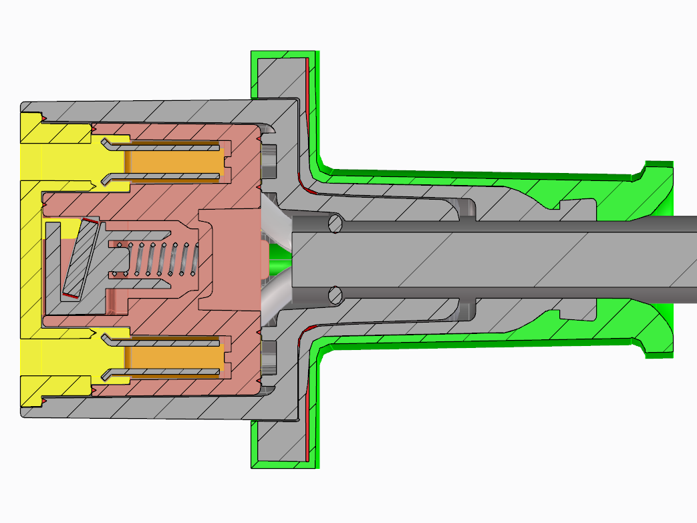
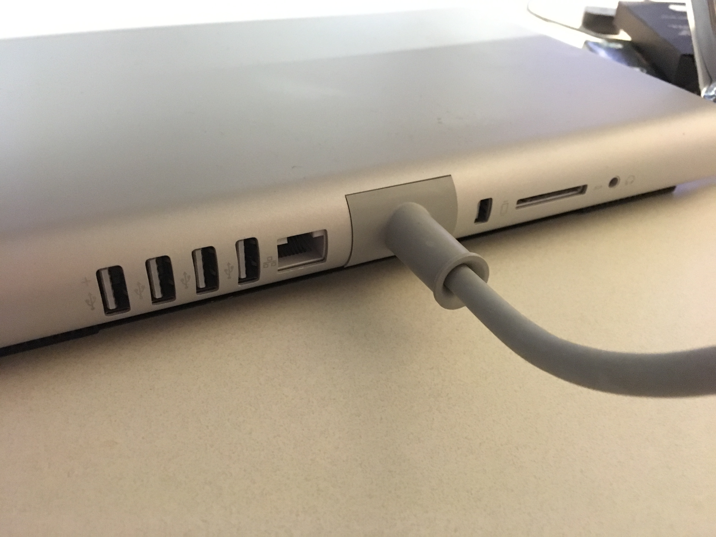
Base AC Plug
Custom-designed plug perfectly matches the curved profile of cover
Strain-relief coupler prevents plug from inadvertently disengaging when pulling on the cord alone

Slide 7
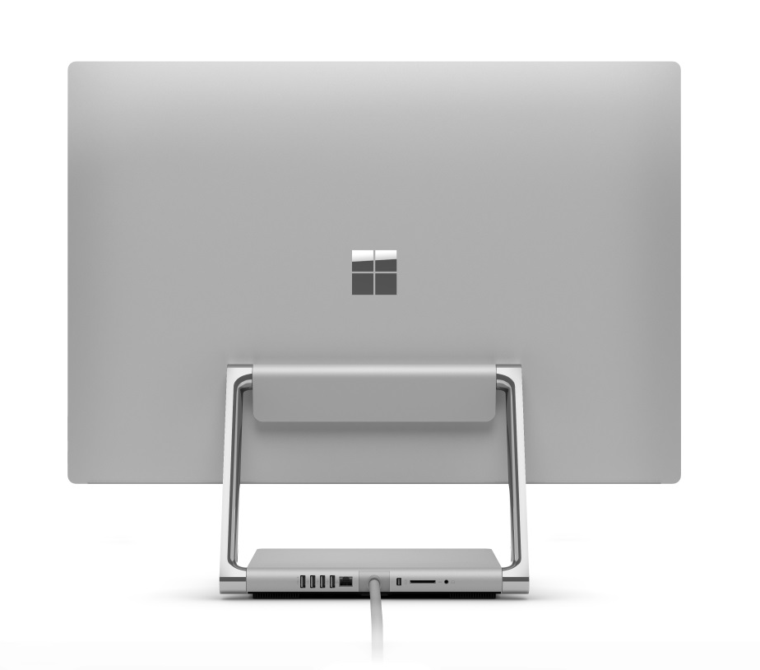
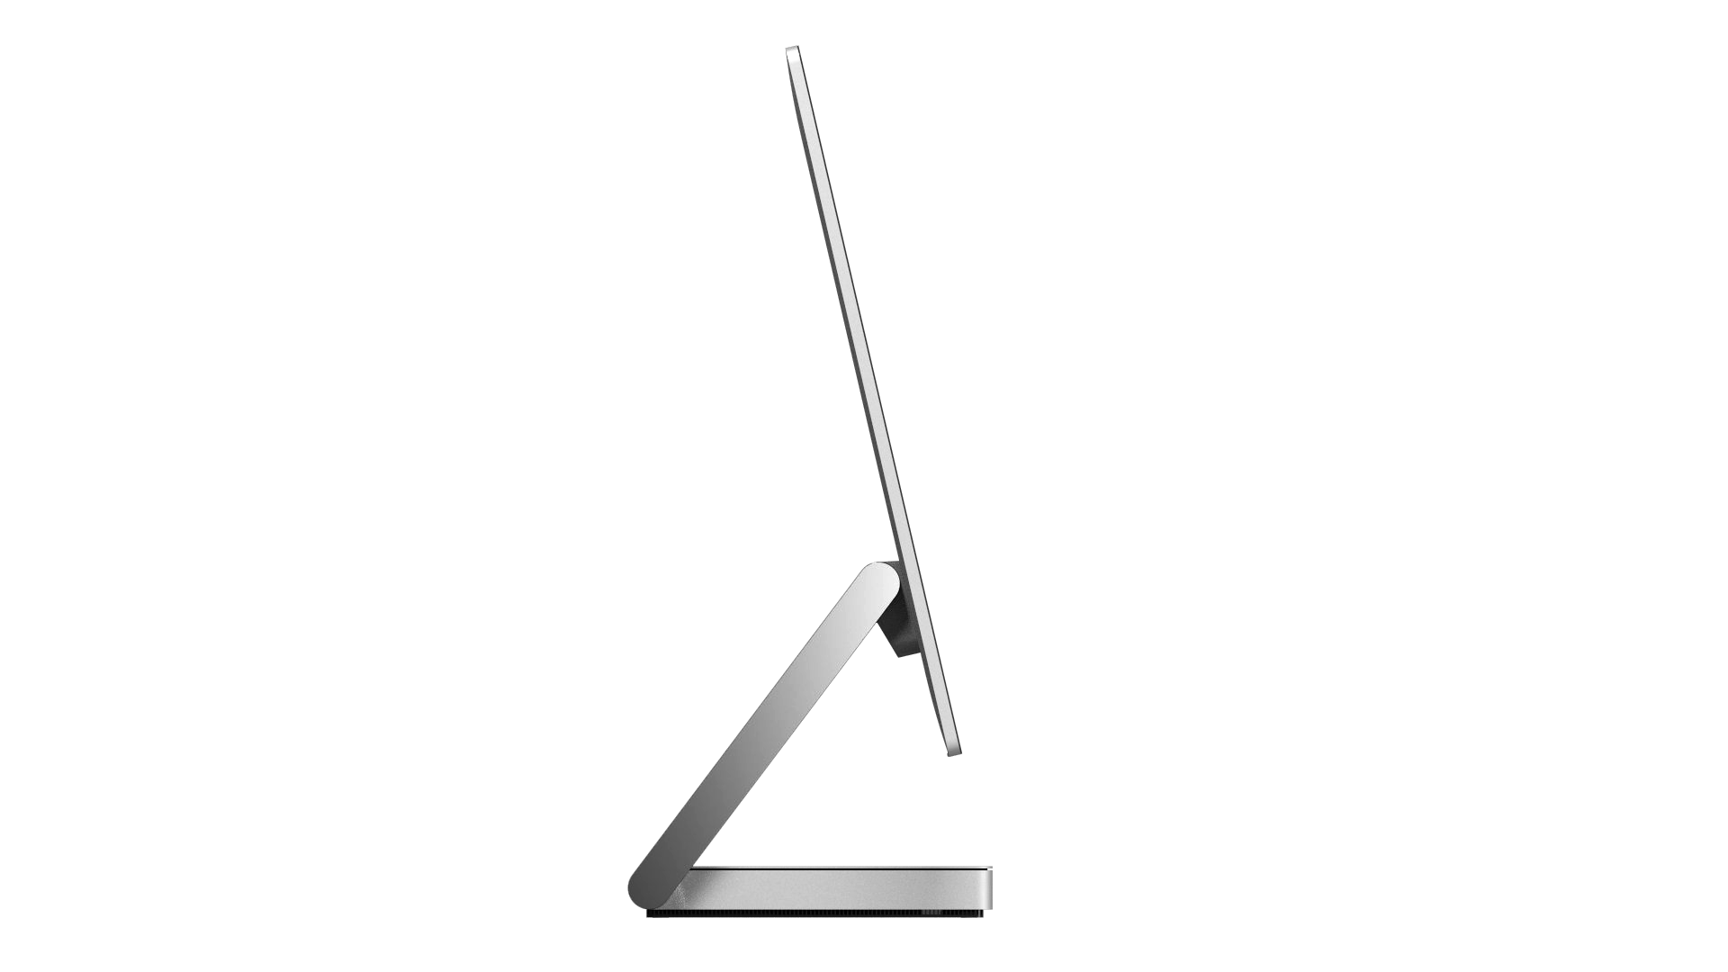
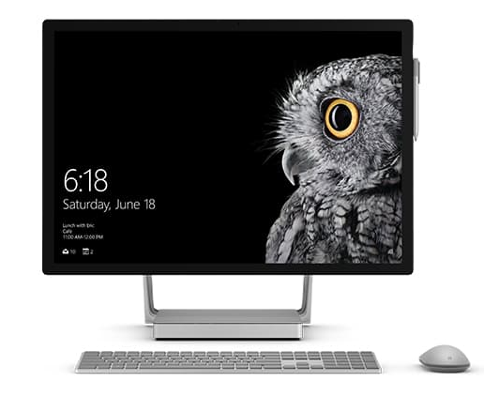
Monitor System
Thin, minimalist design to showcase display quality
Edge-to-edge glass
Narrow bezels
Seamless back cover
Features
5MP Camera with 1080p Video / IR Camera
Power and Volume Buttons
Wi-Fi, BT, Xbox Controller
Dual Microphones
Stereo speakers

Slide 8
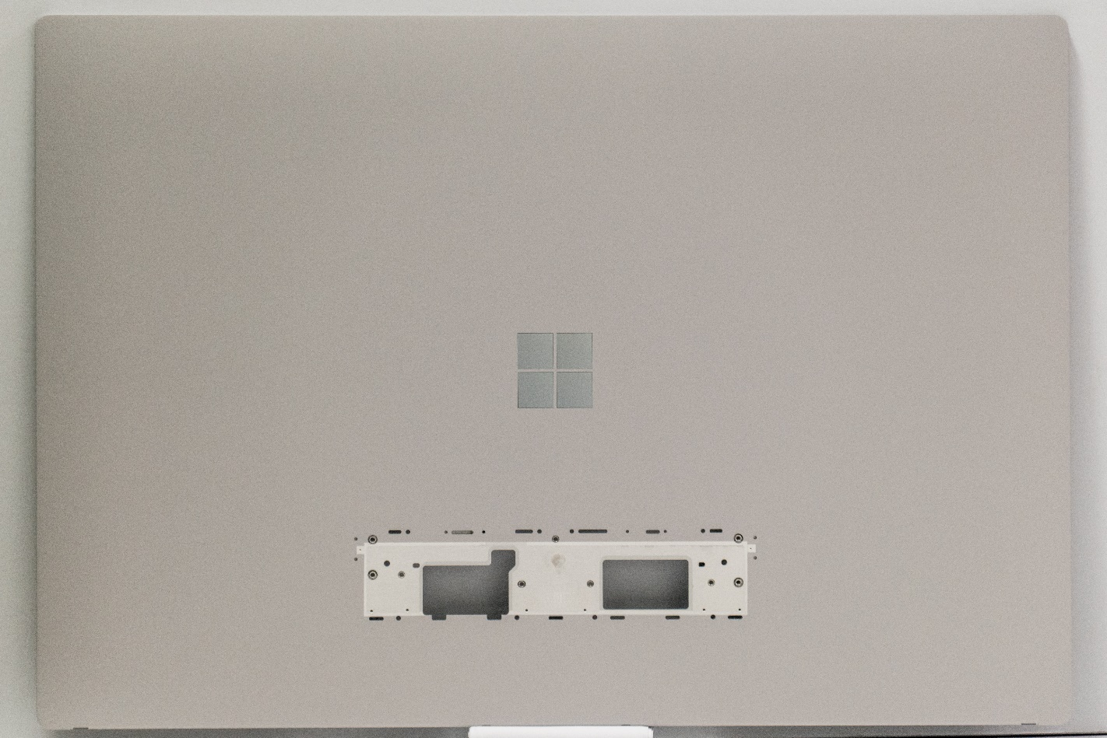
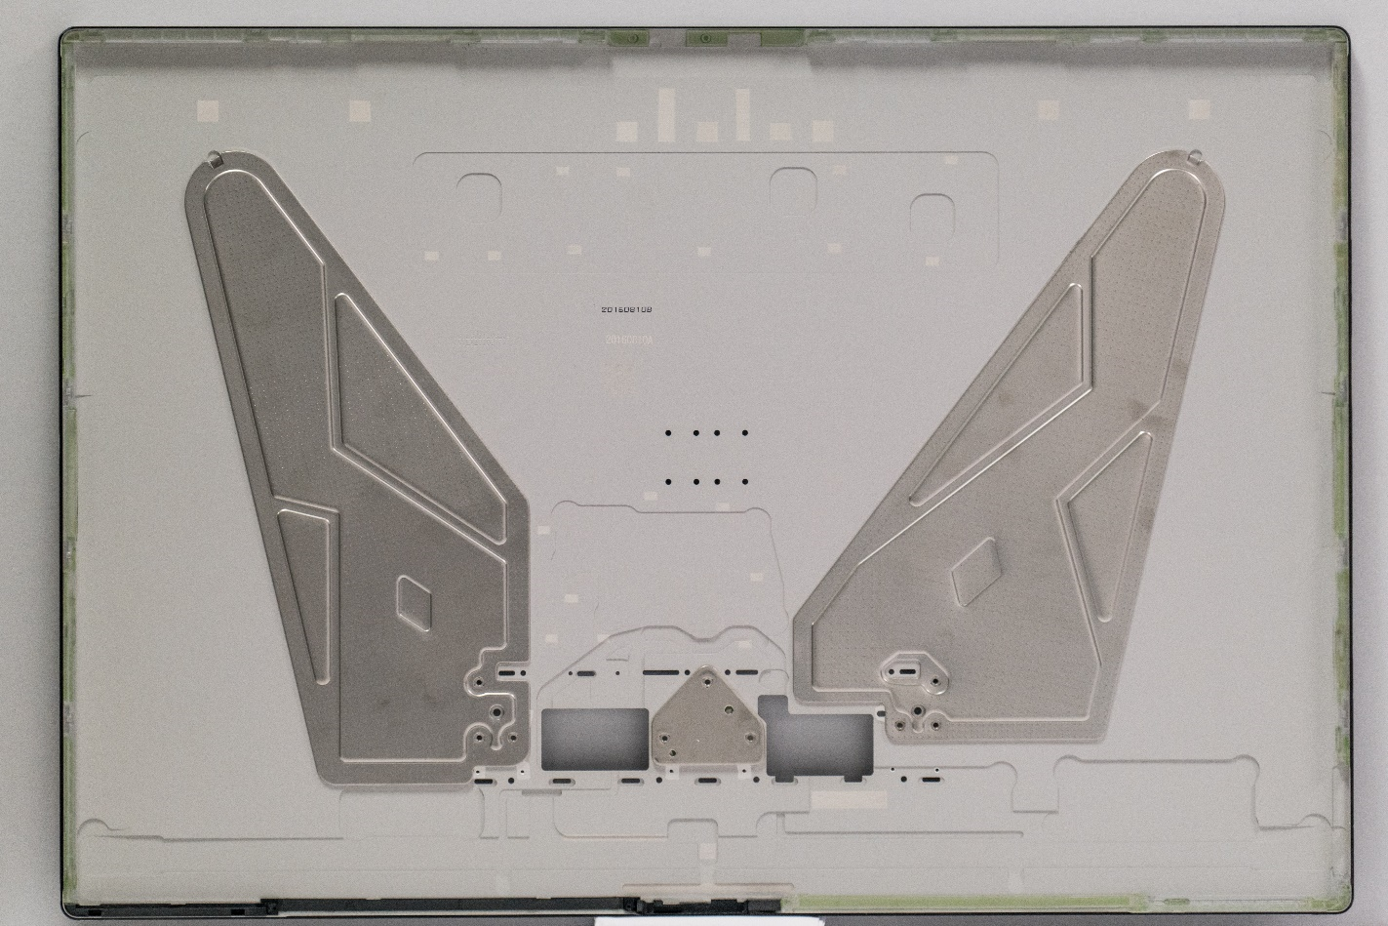
Monitor Back Cover
Aluminum back cover with internal steel stiffeners to provide rigidity and distribute loads from the hinge
Complex fabrication process: stamping, forging, CNC, injection molding, assembly

Slide 9
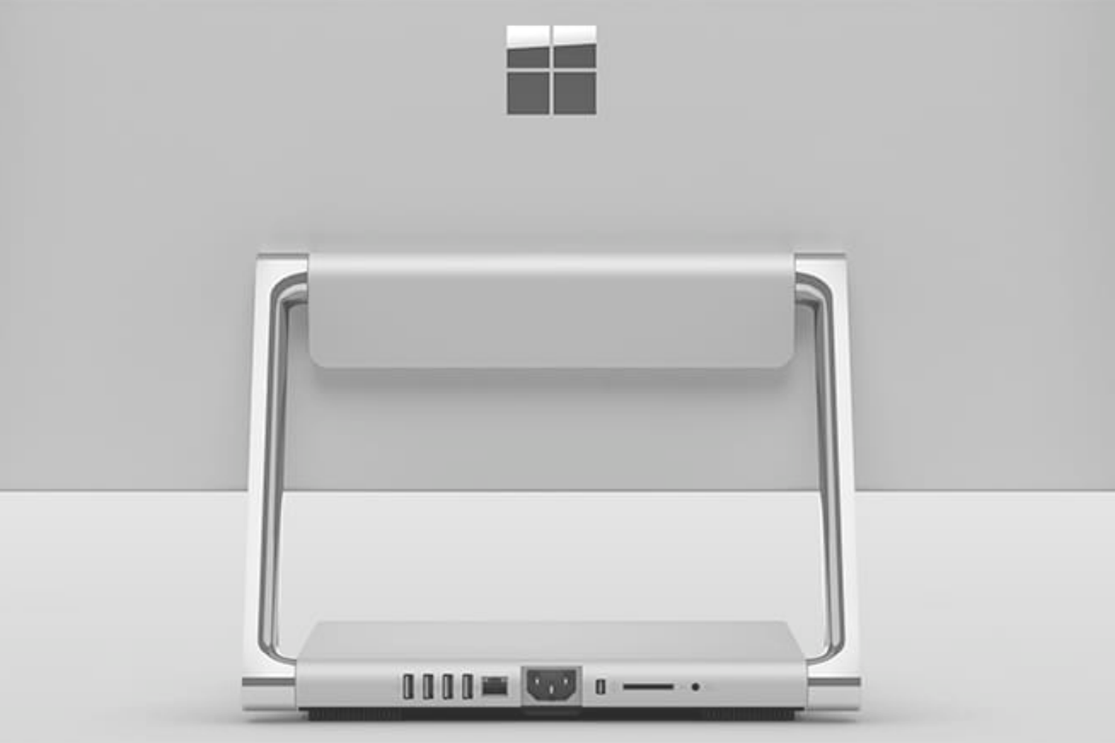
Hinge System
“Zero Gravity Hinge” supports the Monitor and provides effortless transition between the upright Desktop Mode to the 20° Studio Mode
Chrome hinge arms house linkages that control a fixed path of motion, as well as the cable assemblies for signal and power between the Base and Monitor

Slide 10
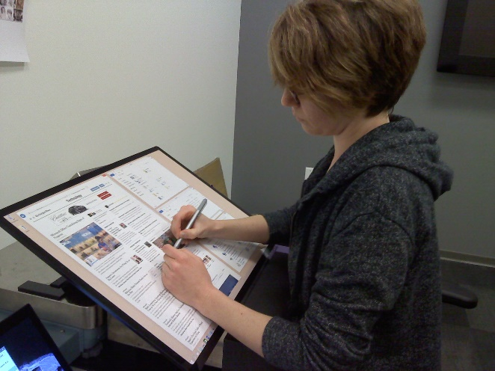
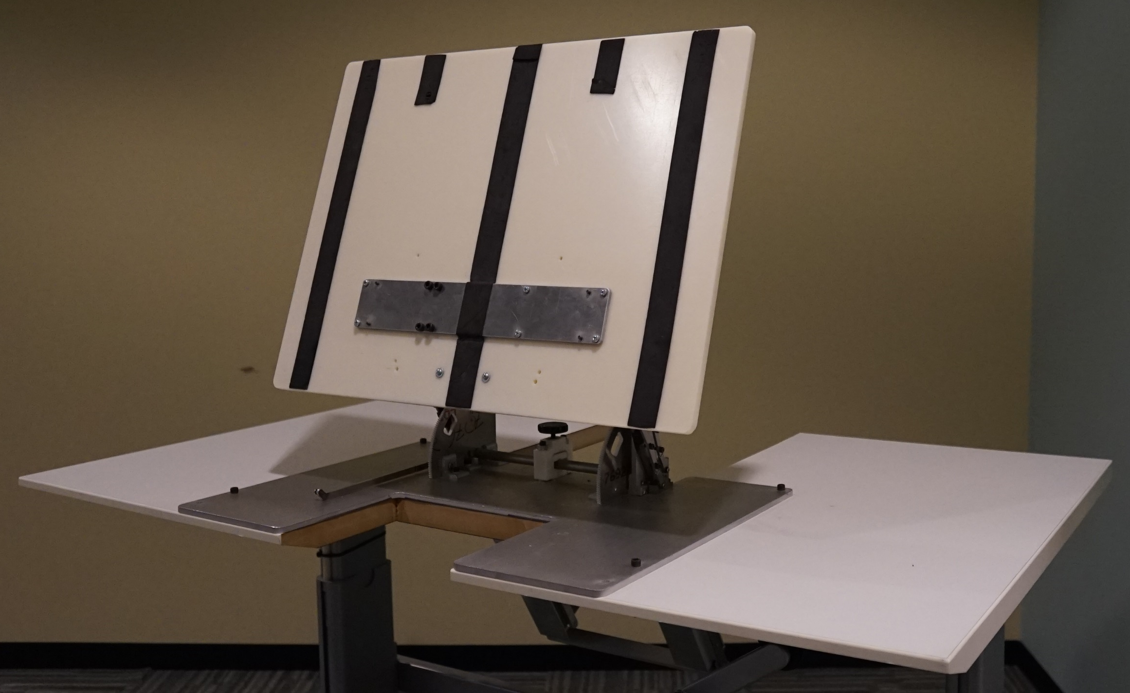
Understanding User Experience

Slide 11
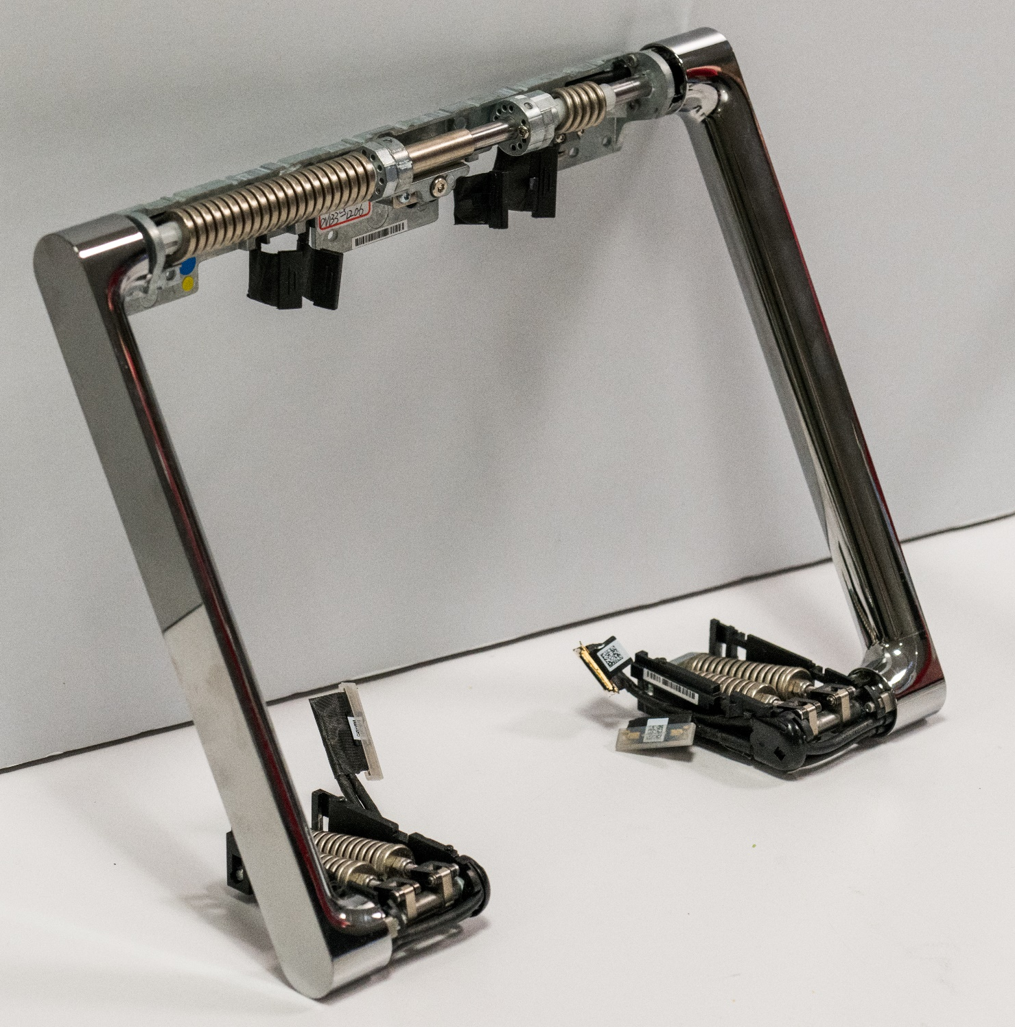
Hinge Counterbalance Spring System
3 sets of springs work together to counterbalance the ~13 lb Monitor through the full range of motion and enables it to feel near-weightless in any position
4 large compression springs in the base (1) are linked through the arms to one large torsion spring (2) that is always engaged and one small torsion spring (3) engaged only during a portion of the motion to perfect the user experience
3
2
1

Slide 12
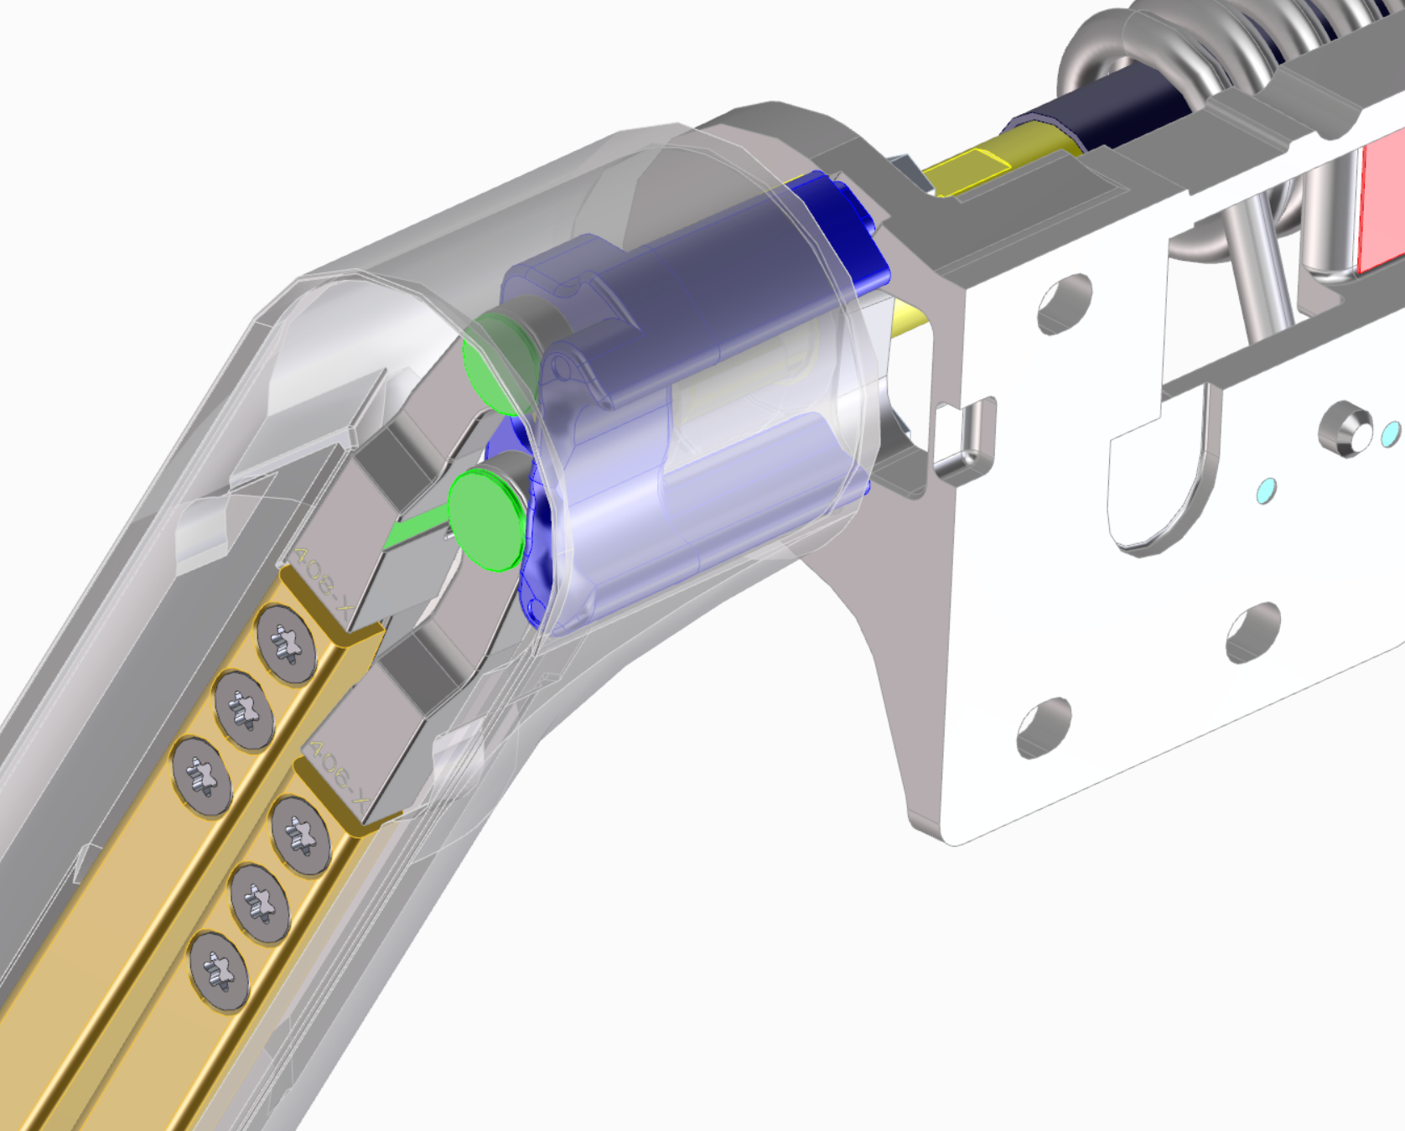
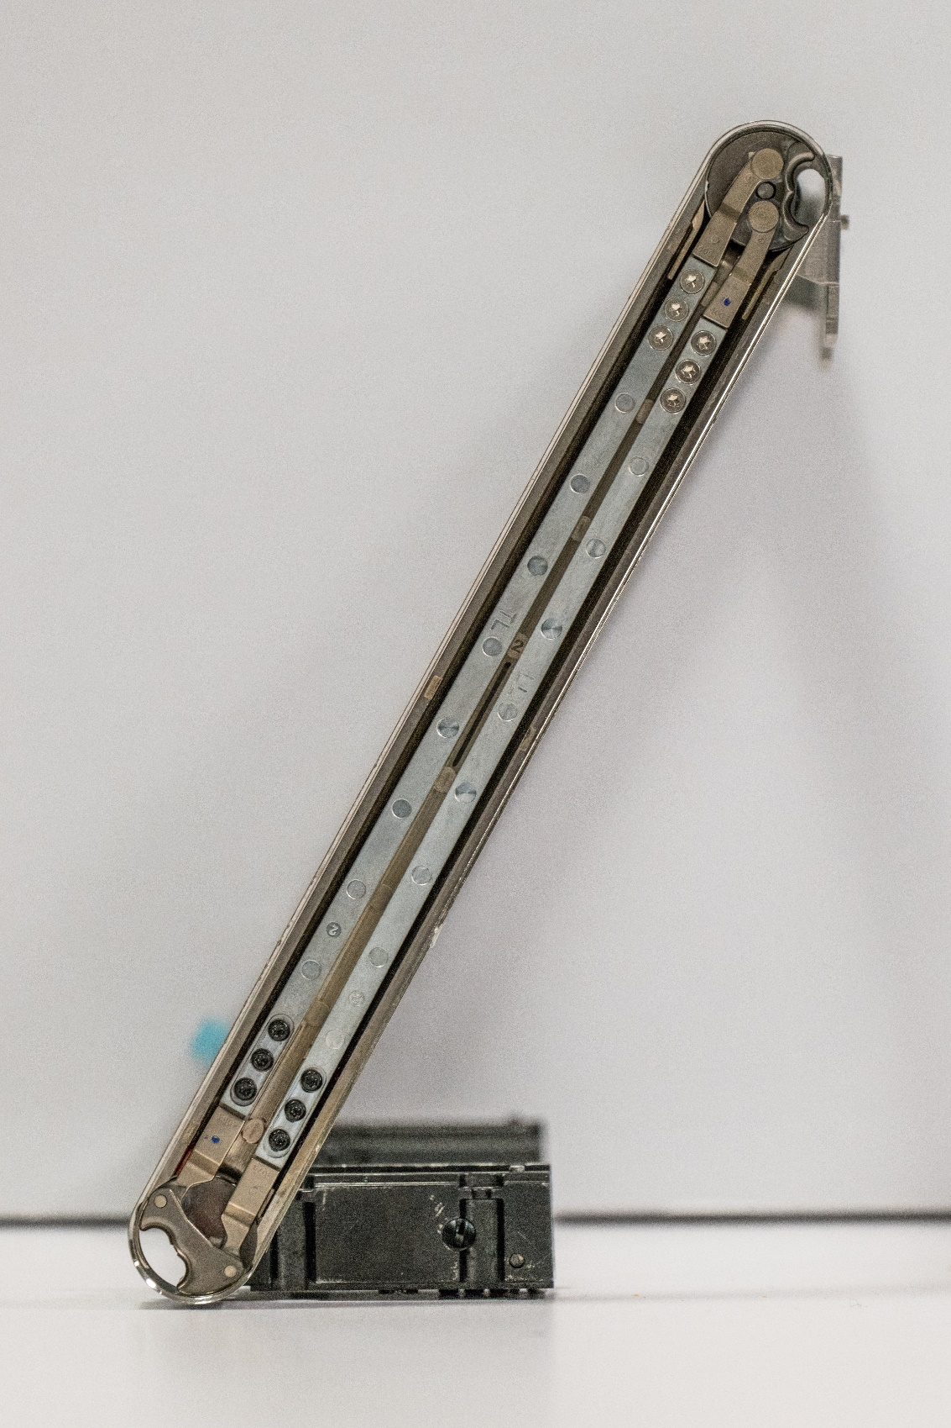
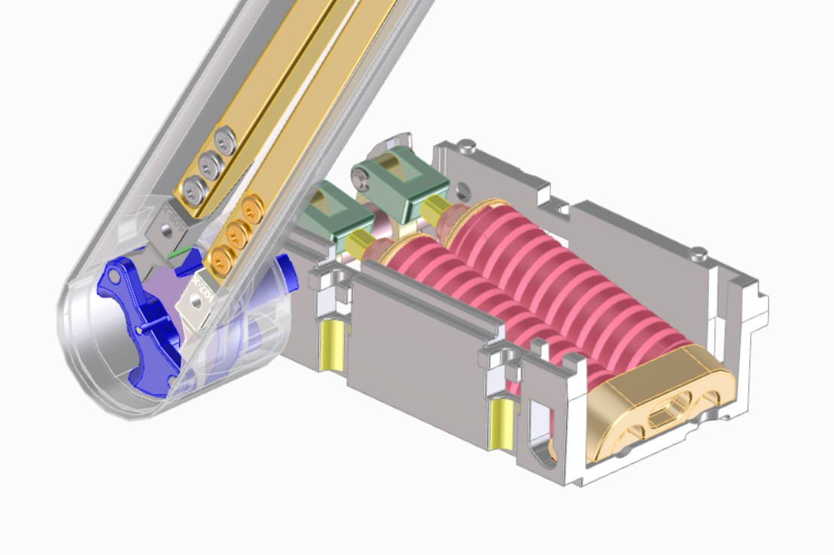
Hinge Arm Linkage
Each hinge arm contains a multi-bar linkage system that translate loads from the top axis to the bottom
The linkage system also sets the path of the Monitor by establishing a relationship between top and bottom rotation

Slide 13
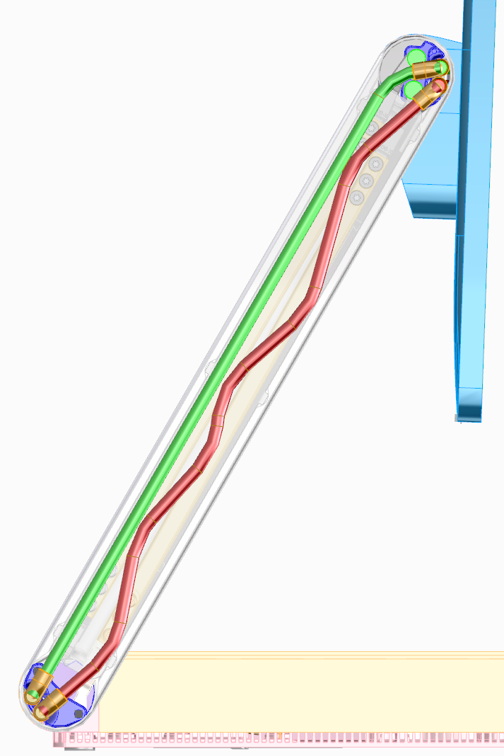
Hinge Arm Cables
2 high-speed, high-density electrical cables route inside the arms and pass through openings into the Base and Monitor
Cables sweep side to side within the arm during hinge rotation, allowing cable stress to be minimized over the very large range of motion

Slide 14
Bringing it Together
We obsessed over every detail during design and manufacturing
Every hinge assembly is custom tuned at the factory with 11 independent adjustments to calibrate for variations in the springs, linkages, Monitor weight and assembly variation
Precision glass alignment to the Monitor housing is achieved via optical alignment and robotic placement

